Slide 1
Bringing the Gallery into your Classroom
Mia Murray

Slide 2
Chosen Themes:
Love and Family
Strength and Power

Slide 3
Art projects
During LGBT+ Black History Month, our school decided to hold a day of celebration.
This was done in various ways.
Drawing, Painting, Colouring, Video and Photography.
Children were encouraged to show diversity in different ways; from how it affected and what it meant to them.
This really linked into the theme of Love and Family.

Slide 4
Our perfect peacock
Children across the school were asked to decorate a simple hand shape.
Once completed these were all put together to create our splendid school peacock.
It represents our school family and all our diversities.

Slide 5
Makaton – to love.
Also, to depict ‘LOVE’ in our Art work, I decided to incorporate Makaton signing into our art work.
With camera in hand, one of our students went around to each class, photographing students and staff, signing ‘TO LOVE’. It was so lovely to see our school ‘family’ joining in this project together. ( this project is still in progress, as I intend to create a heart shaped collage for our Makaton display.

Slide 6
Strength and power
As part of International Women’s Day, I decided to get our class to look at three important female artists and how they have impacted the Arts.
Frida Kahlo
Yayoi Kusama
Bridget Riley
We looked at their three individual styles and re created them in our own way.
Materials : sugar paper, coloured paper, poster paint, pencil, felt pen. Straws (for paint blowing).

Slide 7
Frida Kahlo * 1907-1954
Self Portrait
Frida by a student in Owls

Slide 8
Yayoi Kusama * march 1924
By Various Students

Slide 9
More examples

Slide 10
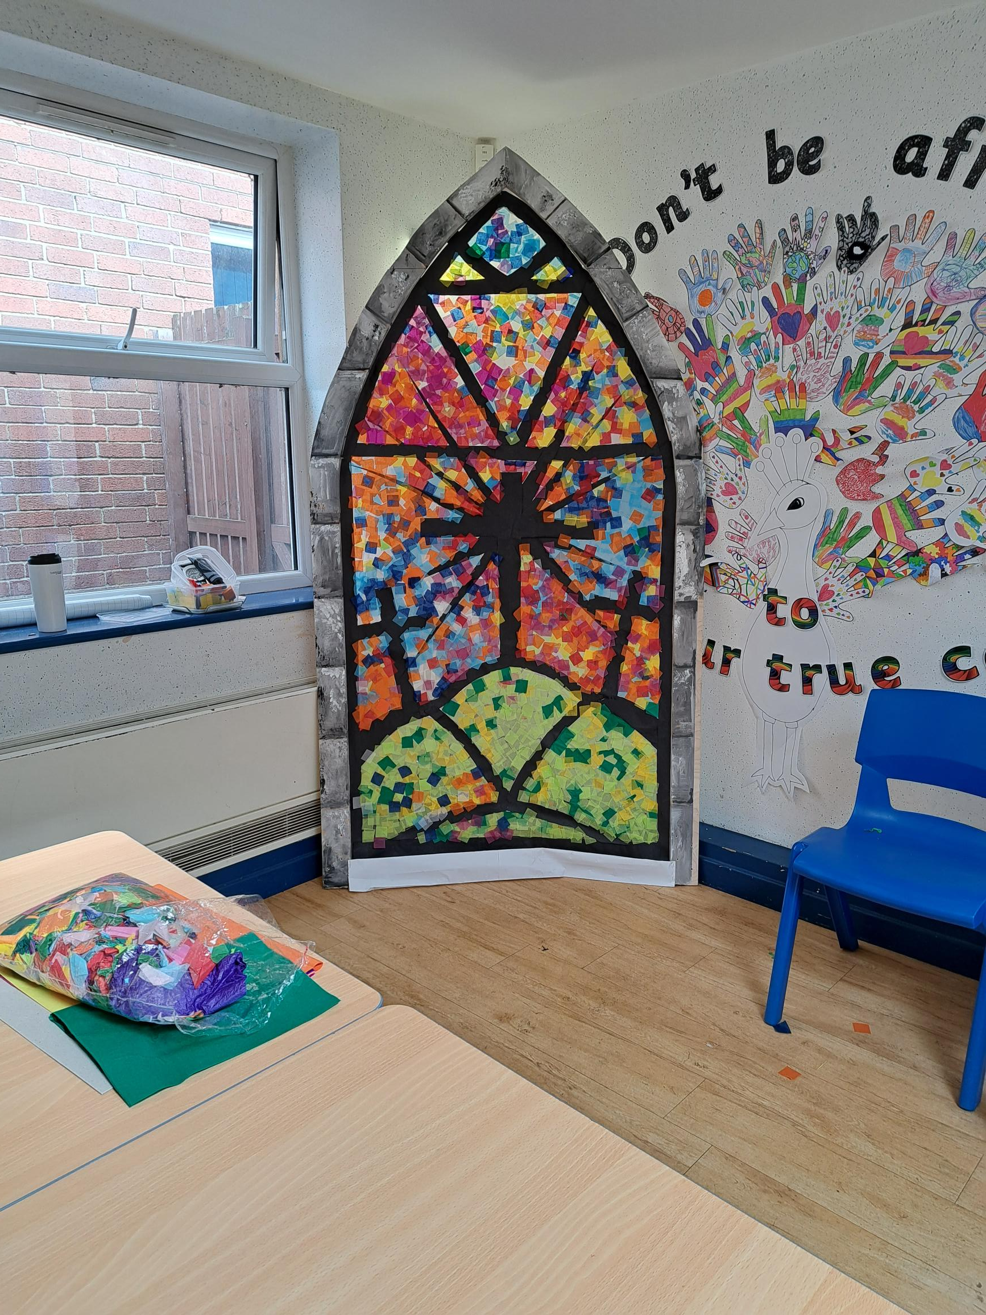
Working together as one
As a whole school project for Easter, we have just completed this fabulous Stained Glass Window.
This will used in our Easter Celebrations this week then will be taken to our local Church for the local community to see.
Materials: wood, paper, sugar paper, tissue paper, sticky back paper, glue.

Slide 11
Working together
COMMUNICATION CONNECTION COMMUNITY

