Slide 1
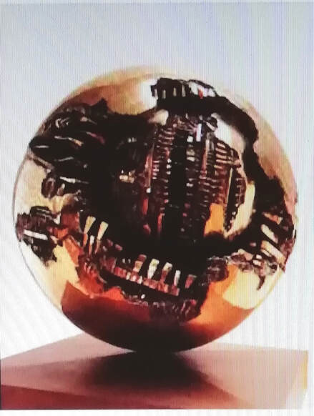
CLASSROOM TECHNIQUES FOR EXPORING ART
An online course to complete alone or in discussion with others

Slide 2
Introduction: This course looks at how global learning methodologies can be used to explore Art in the classroom.
It begins with teacher-level thinking and contains lots of ideas for classroom work.
Each section can be standalone or a cumulative experience.
Art through Global Learning
Global Learning methodologies
Philosophy 4 Children
Working with Images

Slide 3
Many synergies between Art and Global Learning
Both deal with the BIG issues humanity faces, issues with no easy answers or solutions
Both provide contexts to engage with multiple perspectives on these big issues, taking us beyond our preconceptions and broadening minds
Both bring tools (classroom methodologies) to facilitate exploratory learning and engaging with values.

Slide 4
How do children make sense of the world?
How do they process and understand what they see in Art?
What tools can help teachers to promote this type of exploratory learning?

Slide 5
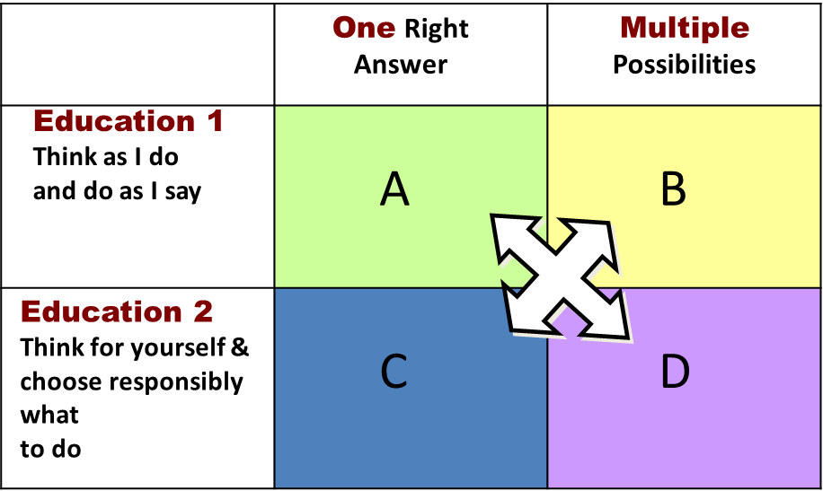
Exploratory learning sits in the D section of this diagram:
In your classroom how often do ‘D’ style learning opportunities occur?

Slide 6
Global Learning Methodologies contribute a great many TOOLS for exploratory learning, through D style learning. These can be very useful for:
exploring meanings in Art
exploring the dilemmas that Art prompts us to think about
engaging with the different perspectives Art invites us to consider
Look at the list on the next slide and spend a couple of moments seeing if you are familiar with any of these classroom methodologies.
If you are familiar with them, consider how you could use them to explore works of Art. The next section will consider some of these with specific works of Art.

Slide 8
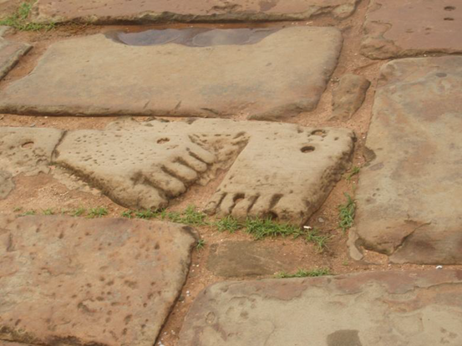
Continuum Lines
Create a line across the hall, either with rope or imaginary,
with ‘agree’ at one end and ‘disagree’ at the other
(or ‘fair’ and ‘unfair’)
Ask learners a series of open-ended values questions
and to stand on the line to demonstrate their view.
There should be no right or wrong answers to the questions
– rather this is an opportunity to explore different perspectives
on the issues Art can explore and a tool to generate exploratory discussions.
Agree -------------------------------------------------------------------- Disagree

Slide 9
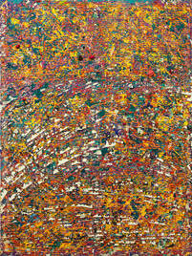
Our World
Display the artwork where everyone can see it.
Ask what the learners think the painting represents?
How does it makes them feel? What can they see?
Using a continuum line with agree – disagree ends, present
the following statements:
The meaning of the art is clear and means the same to everyone
It is fine for everyone to ‘see’ art differently
I like the colour palette chosen
I would like this art in my bedroom
I think the artist has done a good job
Contemporary Portuguese artist, Rui Miguel Leitao Ferreira

Slide 10
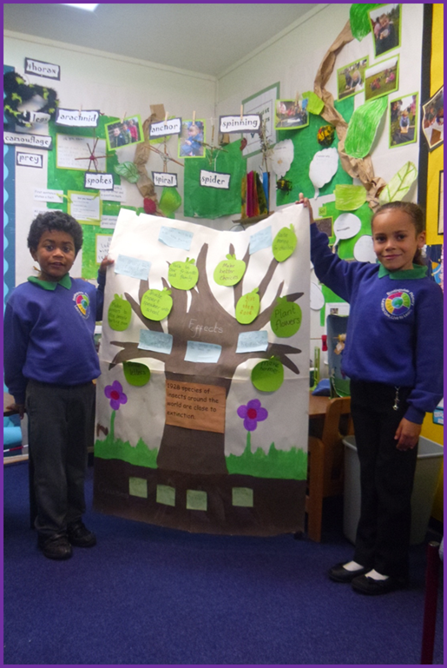
Issues / Solutions Tree
Ask learners to place their question
or issue on the trunk.
Consider causes or roots of the issue or problem
and list them on the roots.
Possible solutions are made into leaves.
You can continue adding new thoughts
as you find out more. This activity can make
a very nice display that can keep being added to.

Slide 11
‘Pyramids of Garbage’ – Installation Art
An 11 m wide, 6 m high pyramid of waste, placed by artist
Bahia Shehab in Cairo, Egypt. By placing an actual pyramid
of rubbish by the great pyramids of Giza, the artwork hopes
to bring attention to the contrast between majestic eternity
and wonder and our current existence of overconsumption
and waste, at the cost of the planet.
Using the artwork as a stimulus use the Issues Tree methodology
to explore the roots of the problem, the dilemmas this raises
and possible solutions to the issues. Artist: Bahia Shehab; Photos: Bahia Shehab, Hadeer Mahmoud, Mahmoud Nasr, Markus Lange
Image thanks to https://fineacts.co/countdown

Slide 12
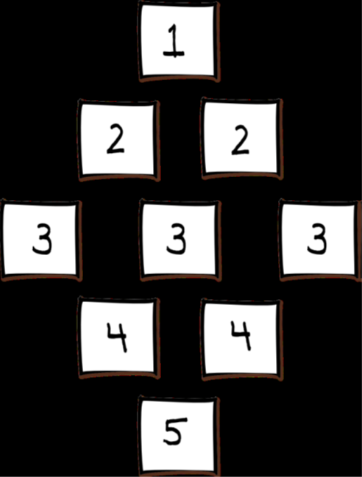
Diamond Ranking Activity: Reasons to look after Bees
Create nine (or more) statements that reflect social and
global issues conveyed in your chosen piece of Art.
Working in small groups, ask learners to
look at the nine statements.
They could add another reason, if they wish.
Ask the group to discuss and agree
how to rank the statements in a diamond shape.
The most agreed with statement goes at the top
and least agreed with statement at the bottom.
Ask learners to discuss and justify their reasons.

Slide 13
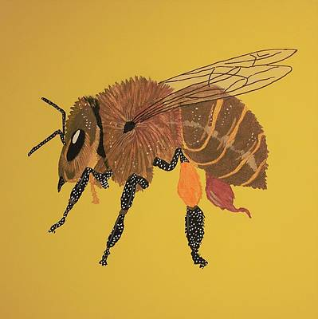
About 1 in every 3 human forkfuls of food is thanks to a bee | Bees pollinate around one sixth of the flowering species world-wide, many trees and many grasses cows and other animals eat | Bees help make our cotton clothes by pollinating the cotton plant
Bees pollinate around 80% of insect-pollinated crops | Honey contains health benefitting substances such as antioxidants, anti-virals and enzymes | Bees are clever and can work out the shortest possible route between flowers
Bees are amazing – their wings flap 11 400 times a minute and they can fly for up to 6 miles as fast as 15 miles an hour. | Bees have an ancient history – fossils dating 150 M years and cave paintings from 7000 BC. | Lots of skincare products use honey and other bee products.
African Honeybee by Ralph Root

Slide 14
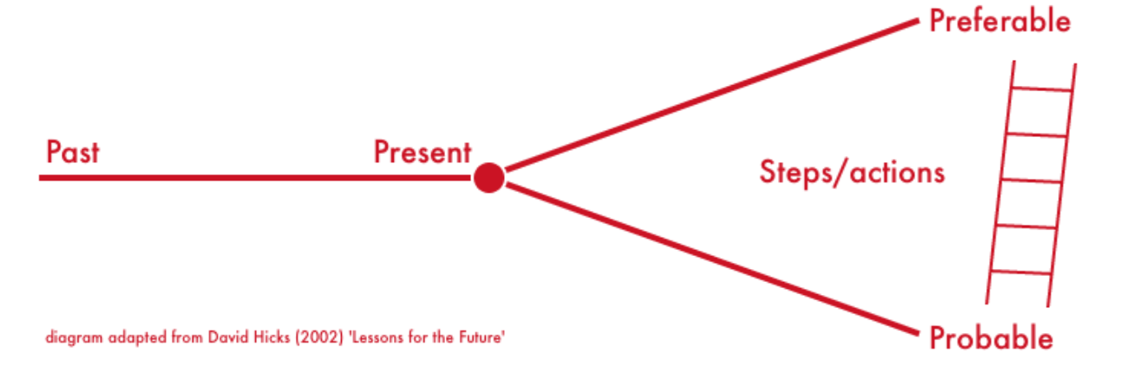
Futures Thinking
Seeing the Artwork as a freeze-frame (present), ask learners to consider what happened in the past of the painting and what might happen in the future.
What is likely to happen next if nothing intervenes?
(Probable future)
What would be a preferable future?
What would need to happen for this to be the case?

Slide 15
The Sound of Temperature Rising Forever: Photography
The heavy smog in the background of the image is a
combination of both the usual LA pollution and the
lingering smoke from the wildfire that was still burning
in the national forest near the city.
Use the Futures Thinking Tool to consider what has happened
in the past to lead up to this moment and what might happen
in the future if nothing changes. Also consider what might happen
in a preferable future and what steps or actions would need
to occur before that could be possible.
The Sound of Temperature Rising Forever by Christine Sun Kim
Photo: Ian Byers-Gamber.
Image thanks to https://fineacts.co/countdown

Slide 16
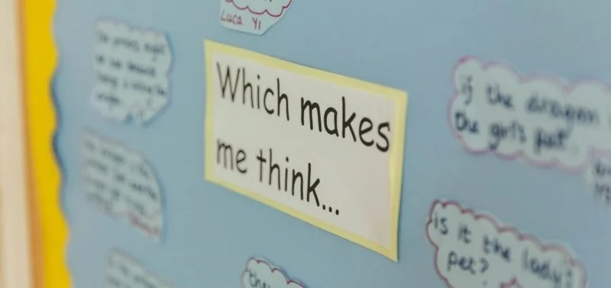
Defined by the professional body Sapere as:
‘A group of people used to thinking
together with a view to increasing their
understanding and appreciation of the
world around them and each other.
Philosophy can be used to improve
teaching and learning, for the lasting
benefit of individuals and communities.’
www.sapere.org.uk
Trickey and Topping (2004) detail a large-scale study in Scotland where children participated in a weekly P4C session.
Statistically significant increases in children’s IQ scores over a period of a year were identified, compared with no increase in the scores of the control group.
The same study showed significant gains in verbal and non-verbal reasoning and along with improvements in listening, communication, behaviour, questioning, reasoning, reading, writing and understanding.
A closing of the gap between low- and high-achievement within classes was also found.
Trickey, S. & Topping, K.J. (2004) Philosophy for children: a systematic review. Research Papers in Education 19 (3) p365 – 380

Slide 17
Philosophy 4 Children (P4C) is a 10-stage approach to philosophical enquiry in the
Classroom:
Preparation
The class, group or community should sit in a circle so that everyone can see and hear
each other. Agree guidelines or ground-rules as a group – these can be re-visited as time
goes on. Warm-up or calm down activities can get everyone in the right frame of mind.
2. Presentation
A stimulus is used at the beginning of the enquiry to generate thinking and questions.
The stimulus can be a story, a picture, a work of art, a poem, a piece of music, a video
clip….in fact almost anything that will stimulate thought and questions in participants
minds.

Slide 18
Thinking time (private reflection)
Allow some silent time for thinking, investigating thoughts and feelings in response to the
stimulus and for processing confusions or reactions. This stage may be recorded in notes,
pictures concept maps etc or may just remain in people’s minds. A ‘First thoughts’ sheet can
be used.
Conversation (shared reflection)
Talking in groups of 2 or 3, people are invited to share their first thoughts and listen to other
perspectives.

Slide 19
Generating questions
The conversation should naturally flow from sharing first thoughts to generating a
question which the pair or three can present to the group. Each pair contribute a
question, which is written up on a flip-chart with the names of the authors.
‘I wonder…’ sheets can be used.
Airing of questions
Each pair are invited to explain or clarify their question (some questions do not
require this!) During the airing stage, questions may also be sorted according to
themes or issues, amalgamated, or linked in some way.

Slide 20
Selection
The whole group votes for the question they would like to go forward to the
discussion. Many voting systems can be used, e.g. closed eyes, three choices
in order of preference, sticky dots etc. A question is chosen for discussion, with the
questions coming second and third held in reserve.
First Words
The chosen question is introduced by the authors and they are asked to say a few
words about why they decided upon that question and the thinking behind it.

Slide 21
Building
Responses to first words are invited from other members of the group. It is important that all members of the group are given the chance to express their opinions, views and feelings about the question in an orderly manner. These are very important skills, developed over time. People must listen to others and consider their views respectfully. A time to revisit the ground-rules if necessary!
10. Final words
Some time is given for private reflection at the end of the discussion. After a few minutes each person can share their final thoughts if they choose. This can be by going around the circle and speaking or by writing something down or drawing, which can be compared to first thoughts before the discussion.

Slide 22
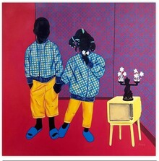
Contemporary French artist Aziseh Emmanuel‘s
colourful painting of two children would make
a great stimulus for a P4C enquiry.
As preparation ask learners, in pairs, to look closely
at the painting first, making observations,
which could be statements starting
I wonder...
https://www.singulart.com/en/artist/aziseh-emmanuel-21105

Slide 23
Quick fire tools for encouraging pupil engagement with pictures:
Speech bubbles
Print a copy of your chosen artwork (with people) and display on the table. Talk about what is going on. Cut out speech and thought bubbles for the people to show what they might be thinking or saying. Stick them on the picture.
Questioning an artwork
Stick a copy of your chosen artwork in the middle of a large piece of paper. Look closely at the artwork and write around it as many questions as you can think of around the picture. Which questions can you answer easily? Which questions need more information? Which questions have no answer? How did this make you think differently about the picture?

Slide 24
Similarities
Look at two different artworks with people. What are the similarities between them? Write down all the commonalities you can see. What are the similarities between the lives of the people in the artwork and yours?
The painter’s view
Choose a painting and pretend you are the artist. Think about: what noises might you hear? What might you smell? What is the weather and temperature? What might you be feeling? Why did you choose to make this painting?
Before and after
Look closely at an artwork and discuss what is happening. What might have happened before this moment? Draw a picture to show it. Do the same for after.

Slide 25
Writing a caption
Examine an artwork in detail and then write a caption for it.
Extending the Painting
Stick a copy of your chosen artwork in the middle of a large piece of paper. Look closely at the painting and try to imagine what is happening outside of it. Draw what you think is happening around the picture.
Adjectives
Choose 6 labels to describe an artwork (eg happy, young, scruffy, embarrassed, strong, poor, worrying, calm) and write these on separate slips of paper. Place the labels on the painting and consider: are the labels positive or negative? How did you choose the label? Does anyone disagree with your label? What evidence did you use?

Slide 26
Your suggestions and comments - please!
We hope you found this online course useful, interesting, thought-provoking and that it has
given you new ideas for working with Art, as well as reminded you of some ideas you already had in your cannon.
The Get Creative with Art Online team would really like to have your feedback and to learn whether you intend
to use any of the ideas shared here in your classroom.
Also, do you have suggestions for expanding this course, which we could add to the GCAO website?
Please contact us through ​ray@globallearningassociation.org
Thank you ☺

