Slide 1
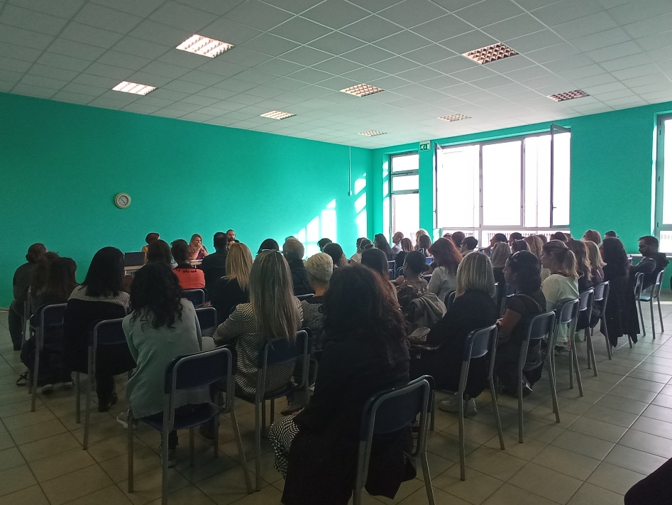
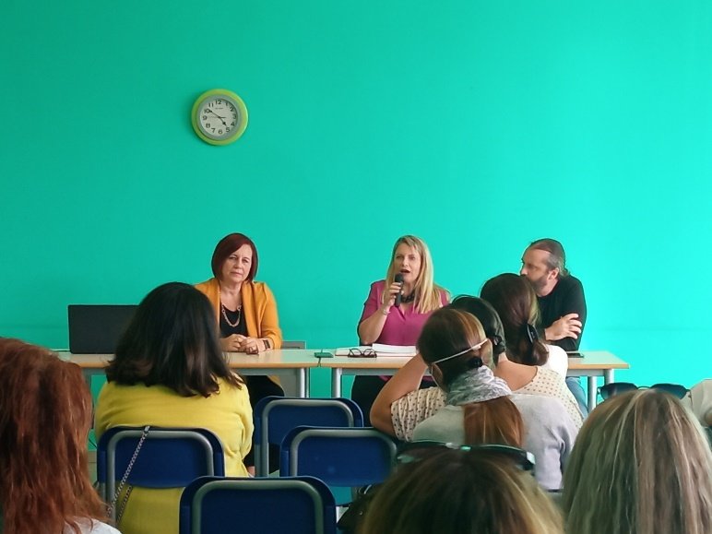
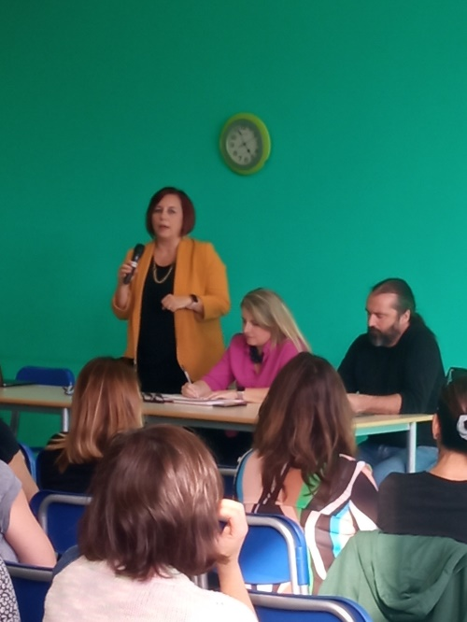
Poppea Sabina Primary and Middle Schools
OCT 2022
This State school has a student population of around 1500 pupils from primary and middle school classes.
It boasts a particular predisposition to art.
A meeting was held with the Headmistress and the school staff, for the presentation of the GCAO project with the participation of about 150 people.

