Slide 1
Welcome to Berghemskolan

Slide 2
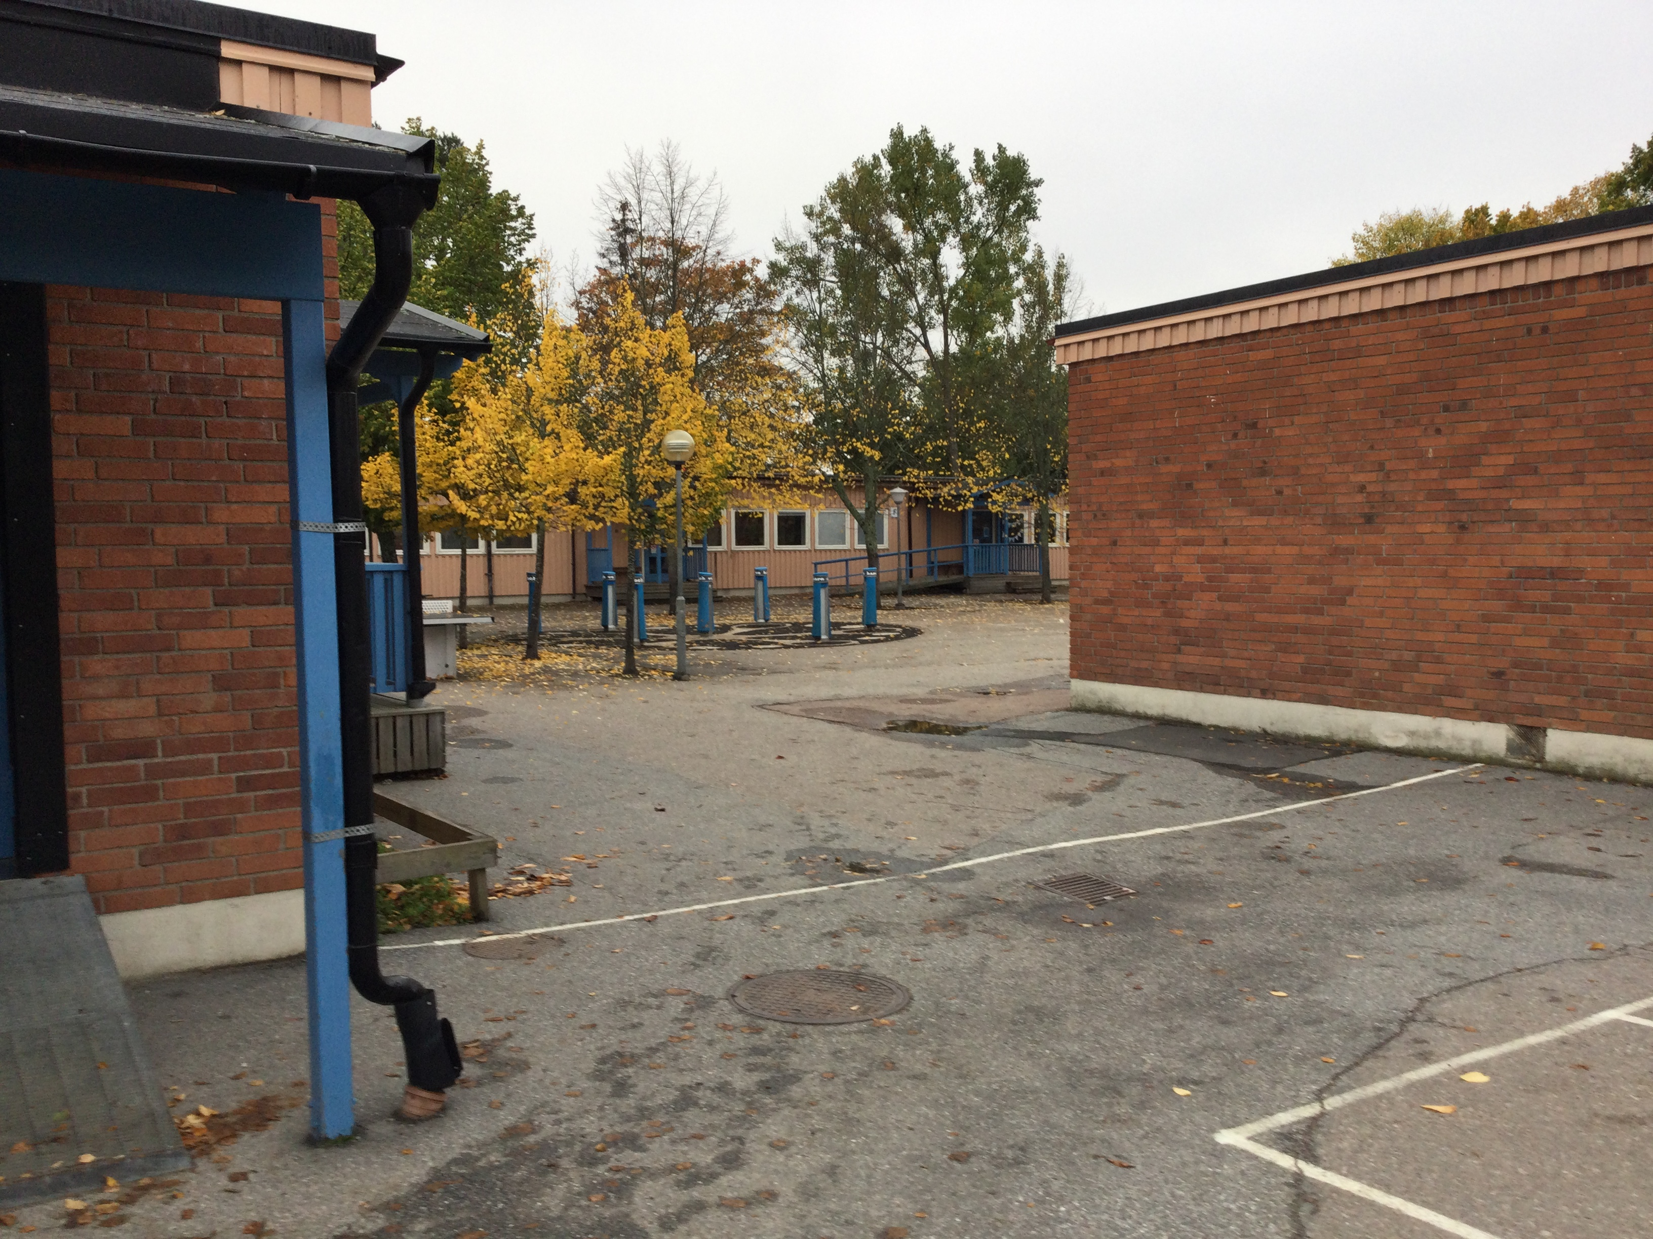
The school is located in Järfälla.

Slide 3
BERGHEMSKOLAN
Public compulsory school
350 students, fk-6 (ages 6-12)
1 principal and 1 assistant principal
15 teachers (included teachers of physical education, music and craft)
2 special education teachers
14 recreational educators (out-of-school care)
1 librarian
1 chef and 2 kitchen assistants
1 school assistant
1 janitor
1 psychologist (50%) and 1 counsoler (60%)
1 nurse (60%)

Slide 4
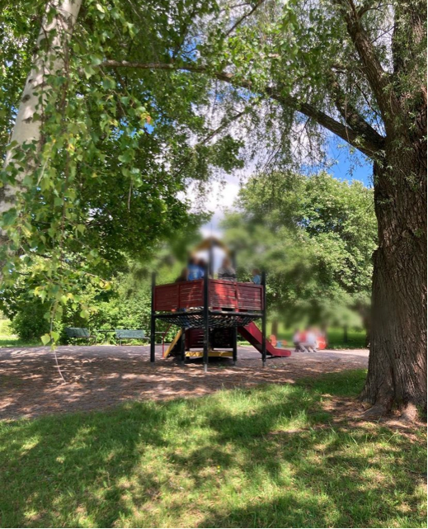
Our school is surrounded by a park and there is a forest nearby, that our students and staff visit daily for both study and leisure.

Slide 5
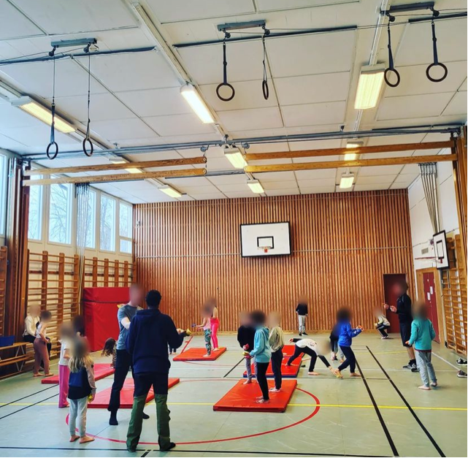
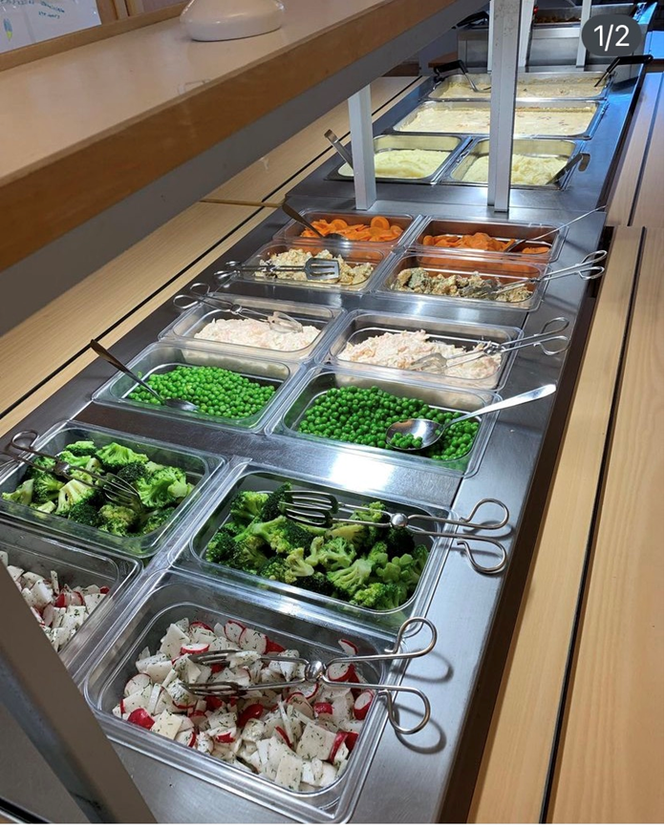
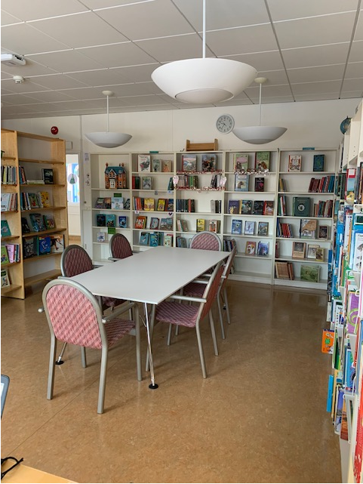
BERGHEMSKOLAN
We have access to a gym for physical education, a library and our own restaurant.

Slide 6
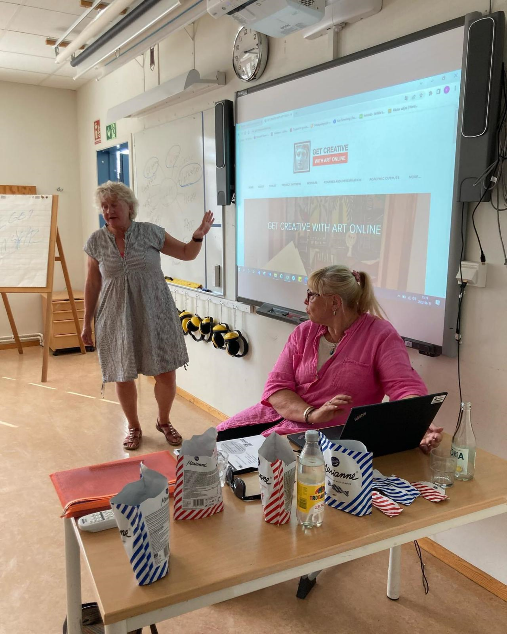
Get creative with art online at Berghemskolan
Spring term 2022 – Christina and Maggis introduced the project to Lisa and Kea (principal/assitant principal) and to the head teachers.
Autumn term 2022 – Christina and Maggis introduced the website and tasks for all staff at the school.

Slide 7
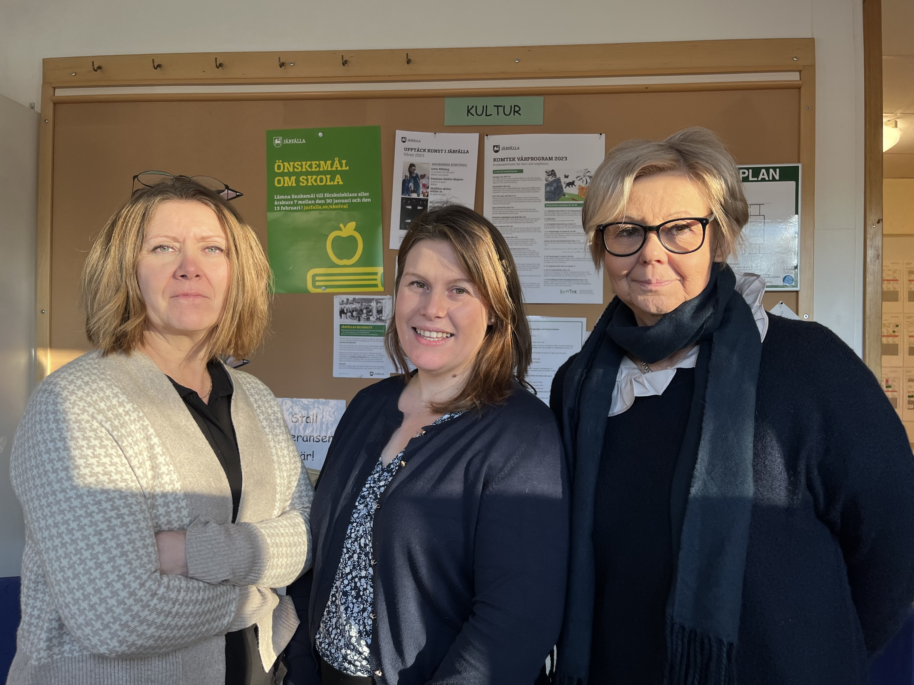
Autumn term 2022 – Alexandra Wastesson - coordinator for the project at Berghemskolan.
My task is to coordinate the contact with Christina and Maggis, the principals and to support the teachers in their work with the modules.
I also administrate the teachers summarising and reflective logs from each module.

Slide 8
The teachers in grade; fk (pre-year), 3, 4, 5 and 6 worked with the modules in class with their students.
The tasks were well described and easy to adapt.
I had the possibility to develop the tasks with my own ideas based on the pupils’ levels and needs.
The students were engaged and the quality of their own work of art has improved.
I’ve been able to work thematically within several subjects through the modules.

Slide 9
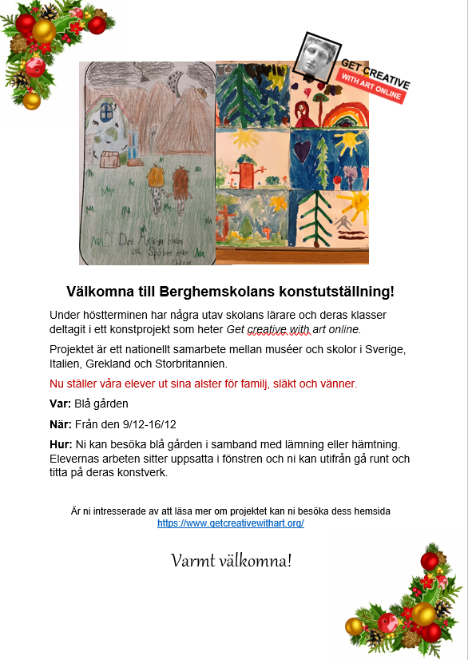
Winter 2022 - We organized an exhibition of the students’ art work and invited family and friends to the school.
It was very appreciated and it made the students come together in school and it created a strong kinship.

Slide 10
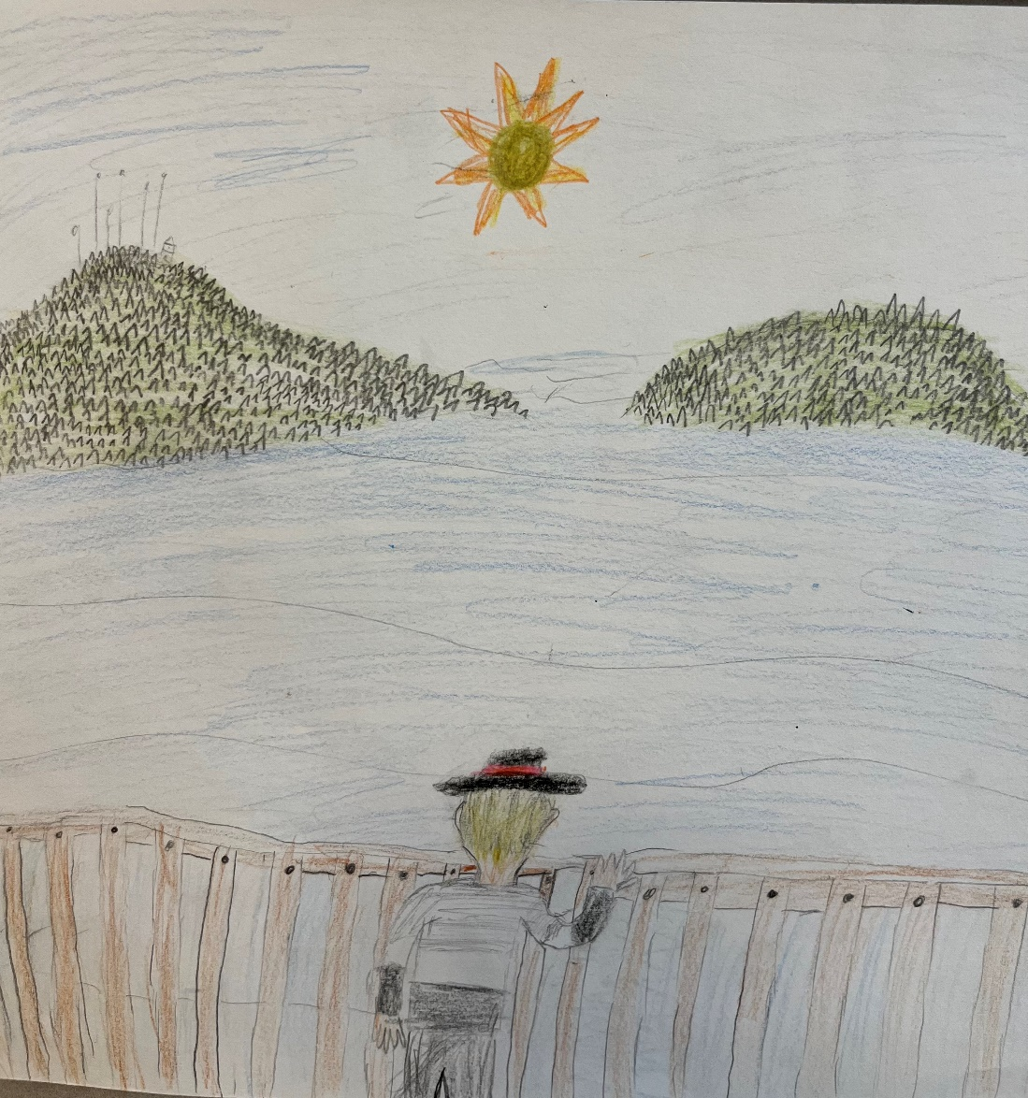
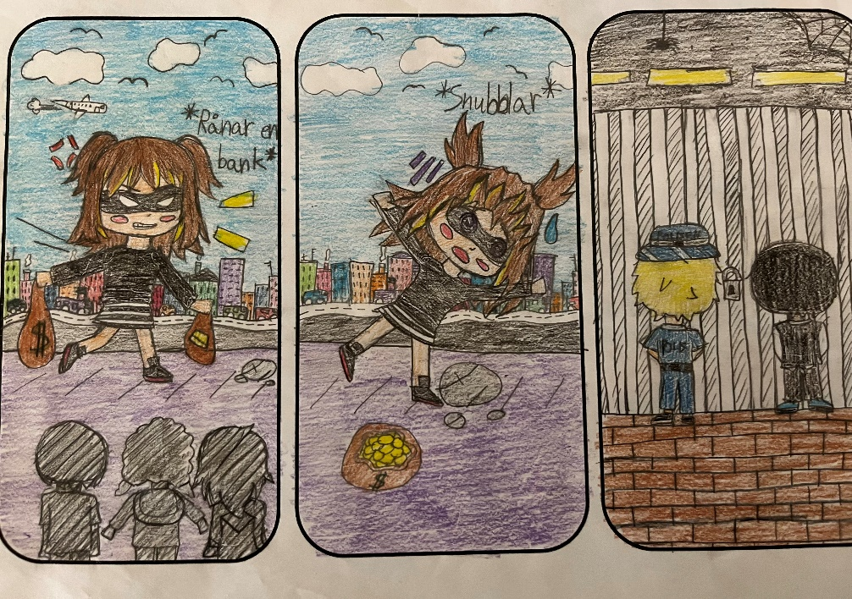
Spring term 2023 – We have continued to work with the modules and we are planning to have a spring/ summer exhibition.

Slide 11
The future…
In the future I wish we’ll continue our work with the modules and that we can extend the cooperation;
between our teachers at Berghemskolan
the schools in Järfälla
and schools abroad

Slide 12
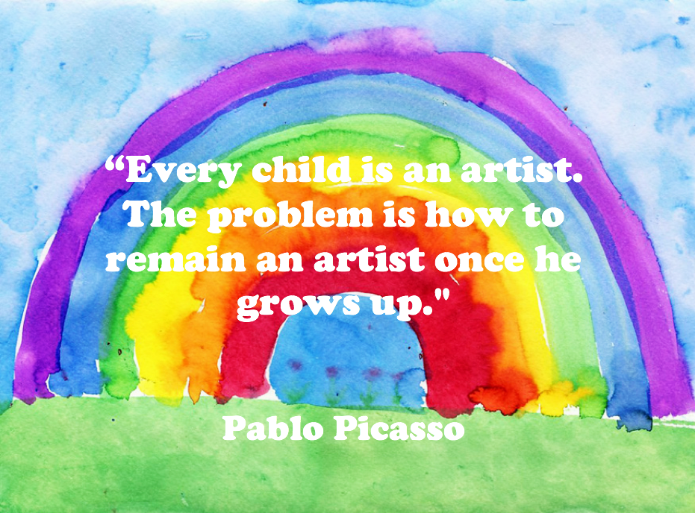
Thank you all, for giving us the oppurtunity to work with well known works of art. The project has encouraged our students and teachers in many different ways and it has given us a unique experince…

