Slide 1
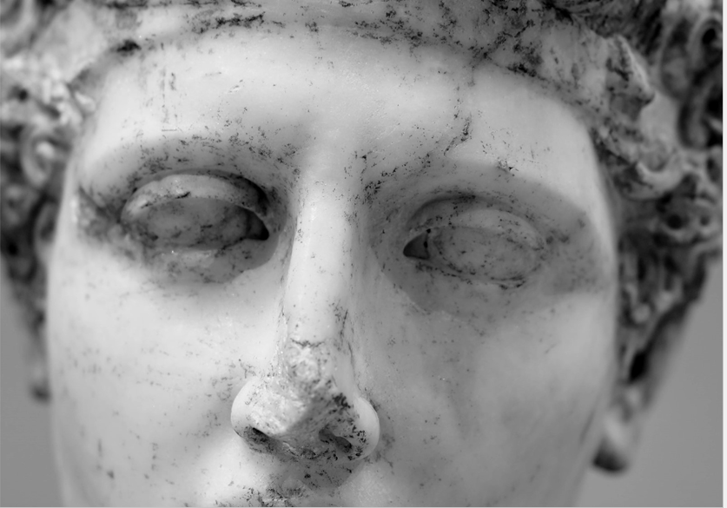
Course Title: "Creative Explorers: Discovering Art and Imagination“ an online art and creativity course for primary school children
Notes:
För: åldrarna 9 – 11 år (Kan bli anpassade för yngre och äldre elever)

Slide 2
Course Objectives:
Help children develop their creativity and imagination through art
Teach children the basics of art, such as colors, shapes, and art techniques
Expand children's English vocabulary, with a focus on words related to art and creativity
Provide children with a fun and safe environment where they can explore and experiment with art
Course Duration: 8 weeks

Slide 3
Course Structure:
Each week, children will have access to a new online lesson that includes an introduction video and a series of hands-on activities.
Activities will include drawing, painting, collage, sculpture, and other forms of artistic expression.
Lessons will focus on different themes, such as nature, abstract art, cartoon characters, and more.
There will also be interactive games and activities to encourage children to use English while they learn and create.
Each week, children will be able to share their creations with other students and receive positive feedback from instructors.

Slide 4
Technical Requirements:
Internet connection
Webcam and microphone

Slide 5
Week 1: Introduction to Art
Learning about the different types of art, such as painting, drawing, sculpture, and more
Basic art techniques, such as mixing colors and shading
Creating a self-portrait

Slide 6
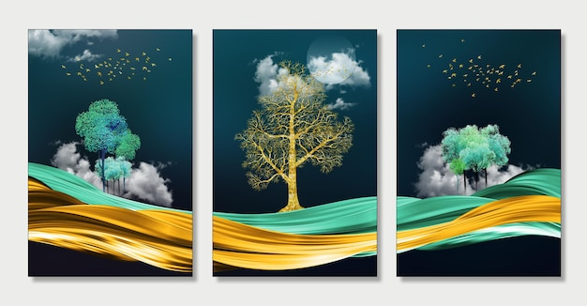
Week 2: Exploring Nature
Drawing and painting landscapes, animals, and plants
Making collages with natural materials
Learning about environmental art

Slide 7
Week 3: Abstract Art
Learning about abstract art and its different styles
Experimenting with different shapes, colors, and textures
Creating an abstract art piece

Slide 8
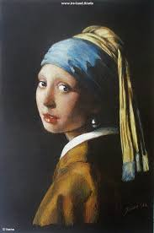
Week 4: Art Inspired by Literature
Reading a children's book and creating art based on the story
Creating illustrations for a story
Learning about famous artists who illustrated children's books

Slide 9
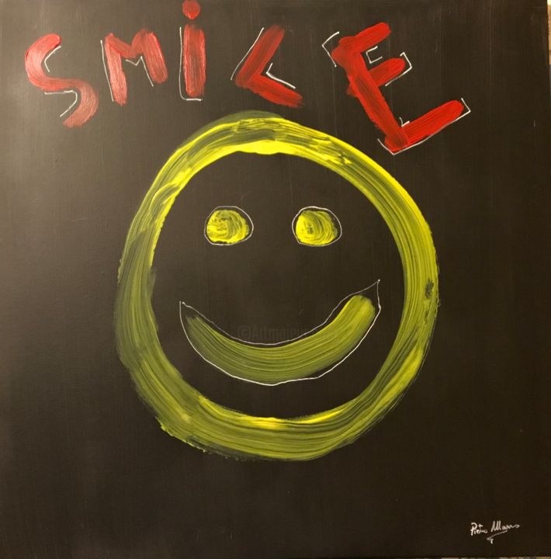
Week 5: Cartoon Characters
Drawing and painting popular cartoon characters
Creating a comic strip
Learning about the history of animation

Slide 10
Week 6: Sculpture
Learning about different sculpture techniques
Creating sculptures using paper, clay, or other materials
Learning about famous sculptures

Slide 11
Week 7: Digital Art
Learning about digital art tools, such as drawing tablets and graphic design software
Creating digital art using a computer or tablet
Learning about the intersection of art and technology

Slide 12
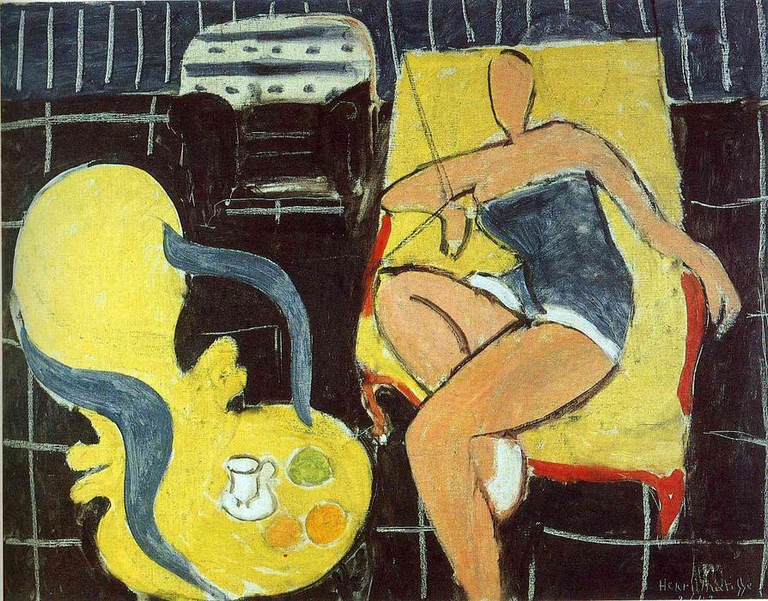
Week 8: Art and Community
Learning about public art and community projects
Creating a collaborative art piece with other students
Learning about the power of art to bring people together

