Slide 1
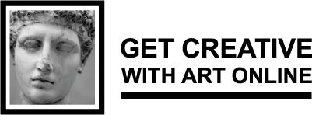
Children´s Perspective on the Modules
SWEDEN

Slide 2
The main questions:
Is it possible
and what do you gain
by working with current social themes by art?

Slide 3
Alexandra Wastesson,
Teacher Berghemsskolan

Slide 4
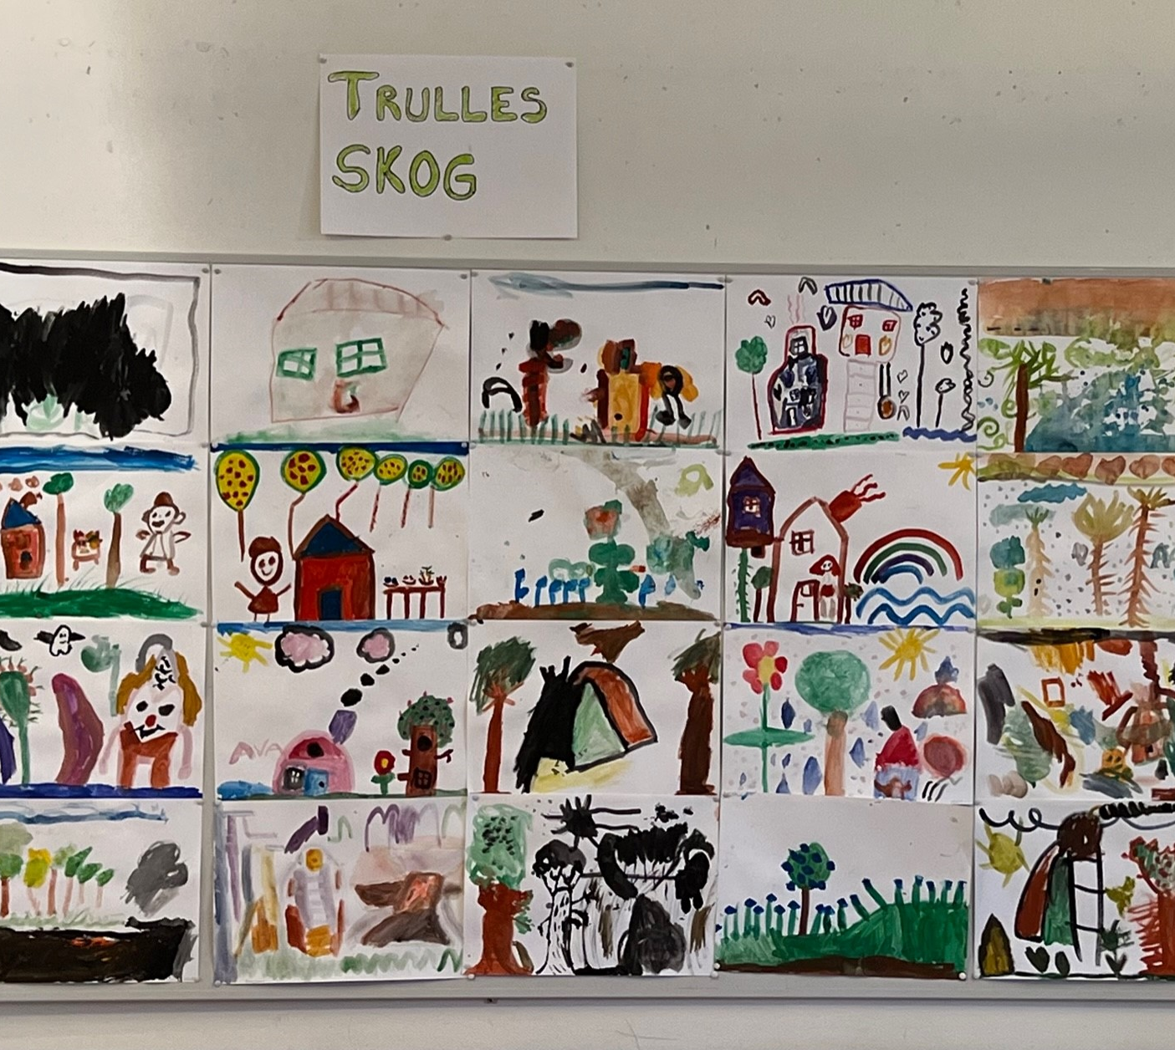
From the module ”Nature”,
childen aged 6, Berghemsskolan

Slide 5
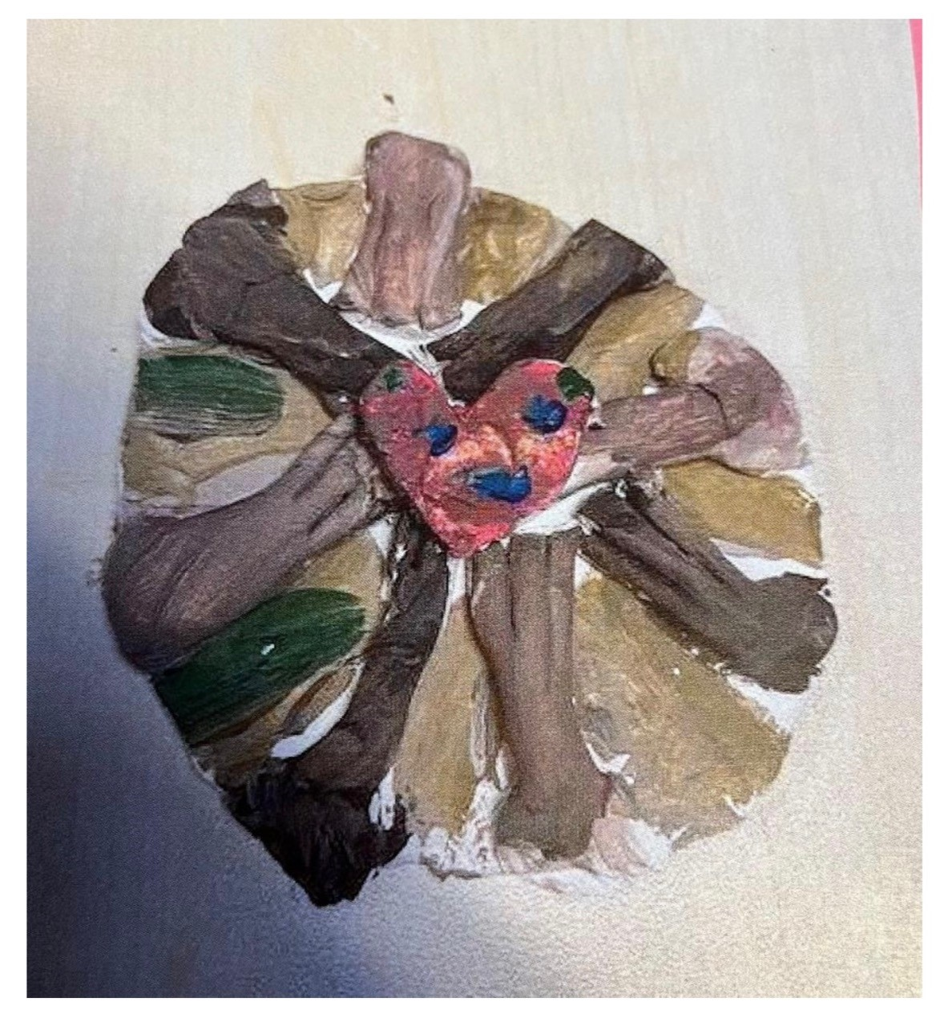
From the module
”Our World” in artistic clay
Berghemsskolan

Slide 6
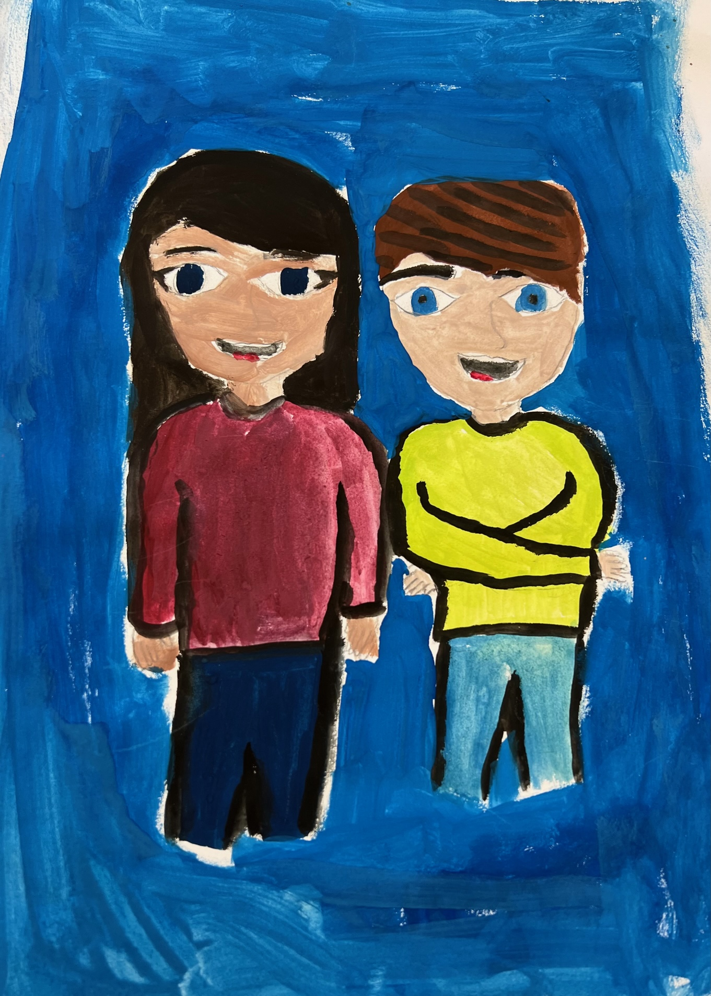
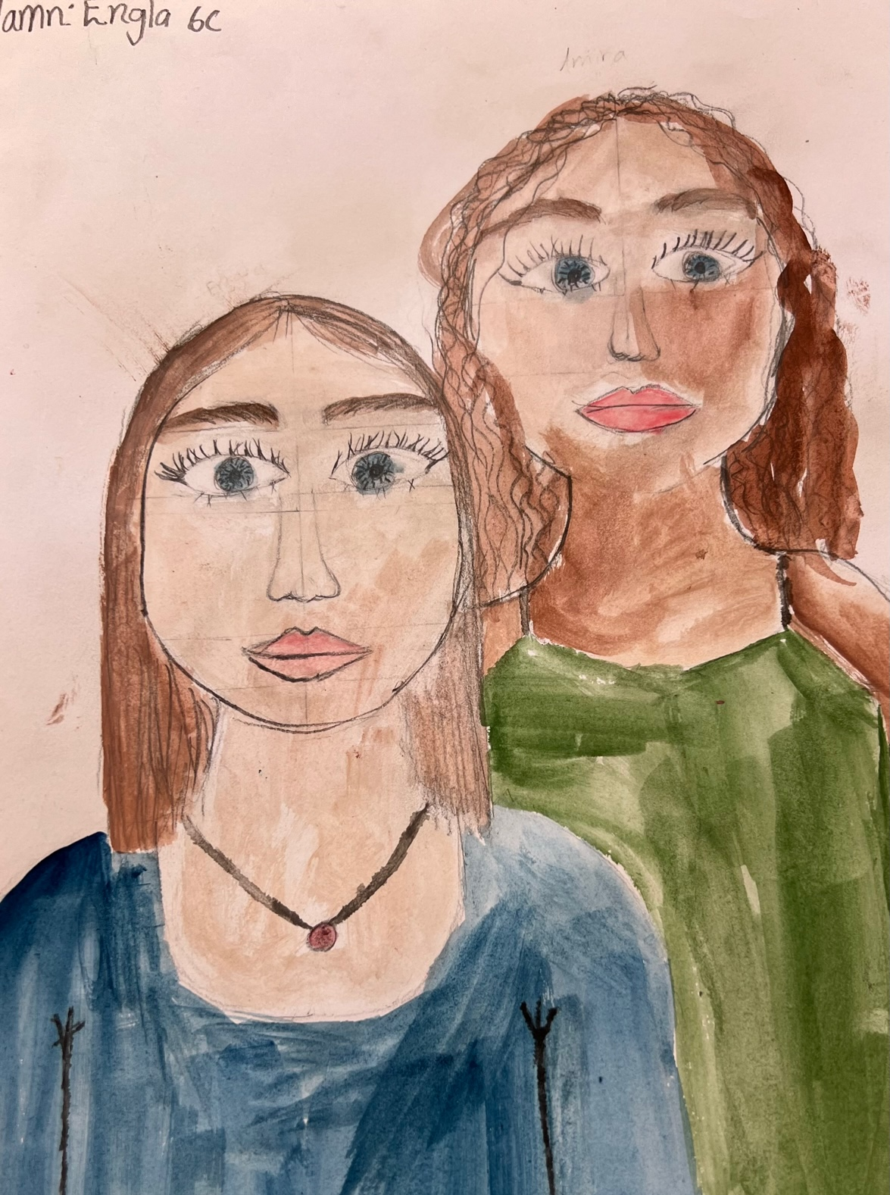
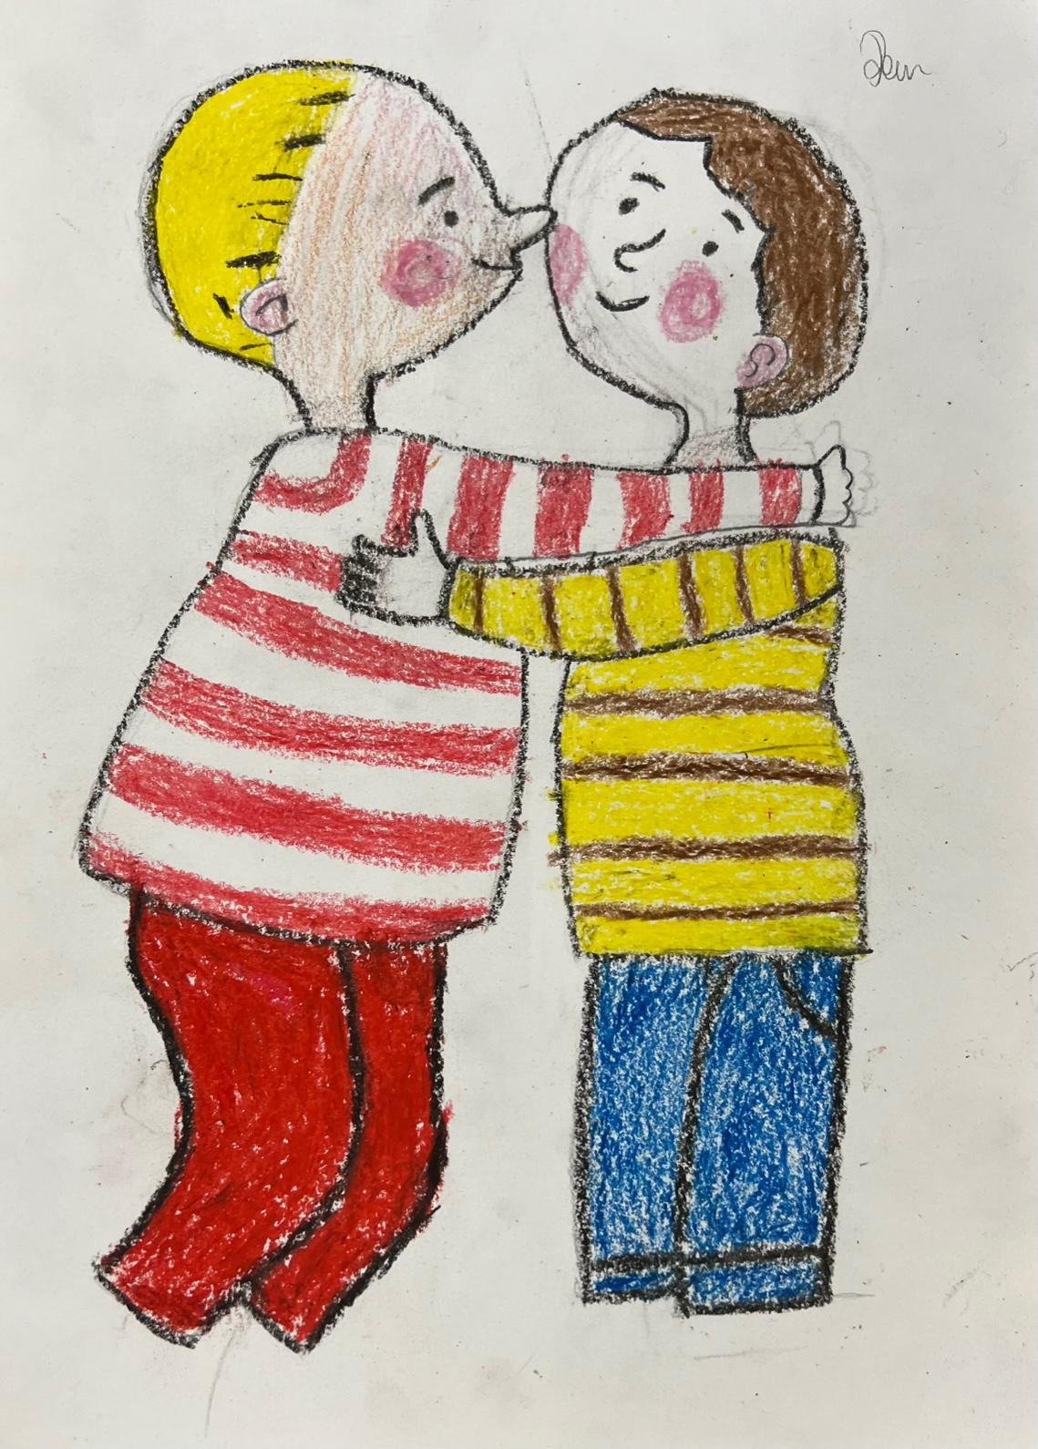
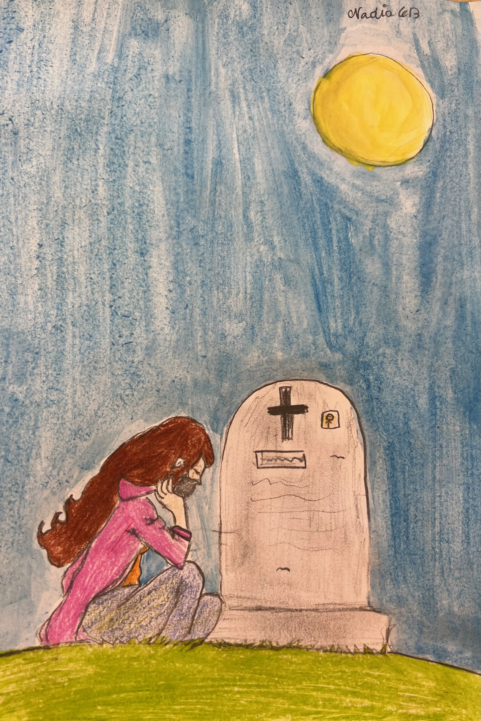
From the module
“Love and Family”
Skälbyskolan, Järfälla

Slide 7
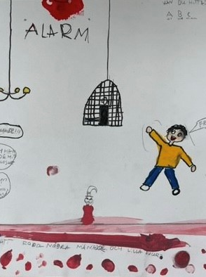
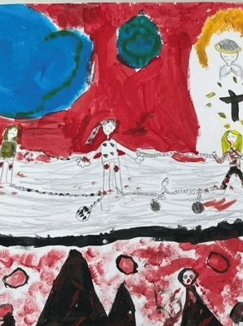
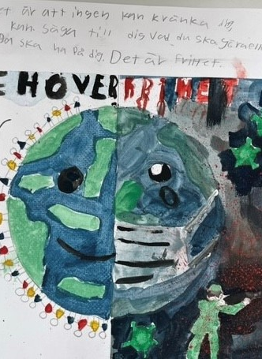
From the module
”Freedom”
Olovslundskolan, Järfälla

Slide 8
Elisabeth Ejrefalk,
Head Teacher,
Berghemsskolan, Järfälla

Slide 9
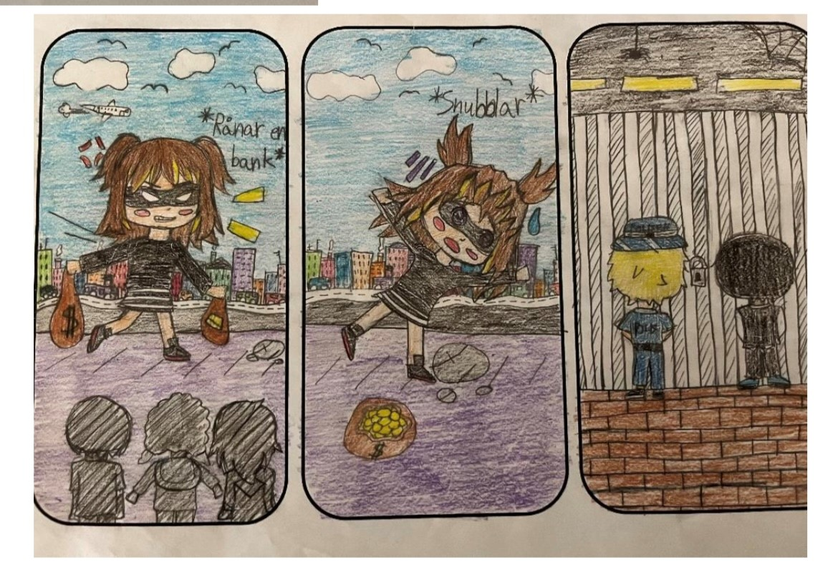
Art lesson task: make a comic strip
Pupil aged 12, Berghemsskolan

Slide 10
Some voices from the pupils:
Freedom is to go to school…
I miss my grand mother who died in covid….
Freedom is letting the animals free…
Can two boys have a child together?
Freedom is important to people
Freedom is to decide what clothes you are going to put on in the morning
Freedom is not to be bullied
Friendship is so important to me.

Slide 11
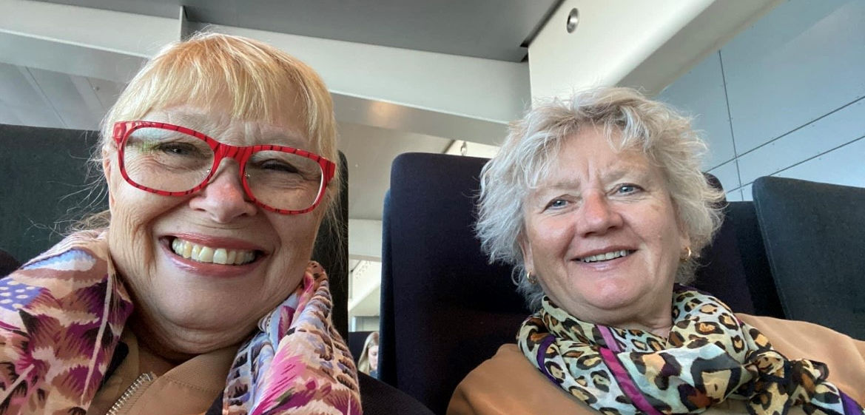
Bye from Christina and Maggis

