Slide 1
The Vasa Museum
Strength and Power

Slide 2
The Vasa, pride of the Swedish Navy, set sail on her maiden voyage 10th August 1628.
After just 1,300 metres she sank
After 333 years she was salvaged from the sea bed in Stockholm harbour and eventually rebuilt.
She is 98% original
She was exceedingly ornate – artistic in her design with significant features showing her STRENGTH and POWER.

Slide 3
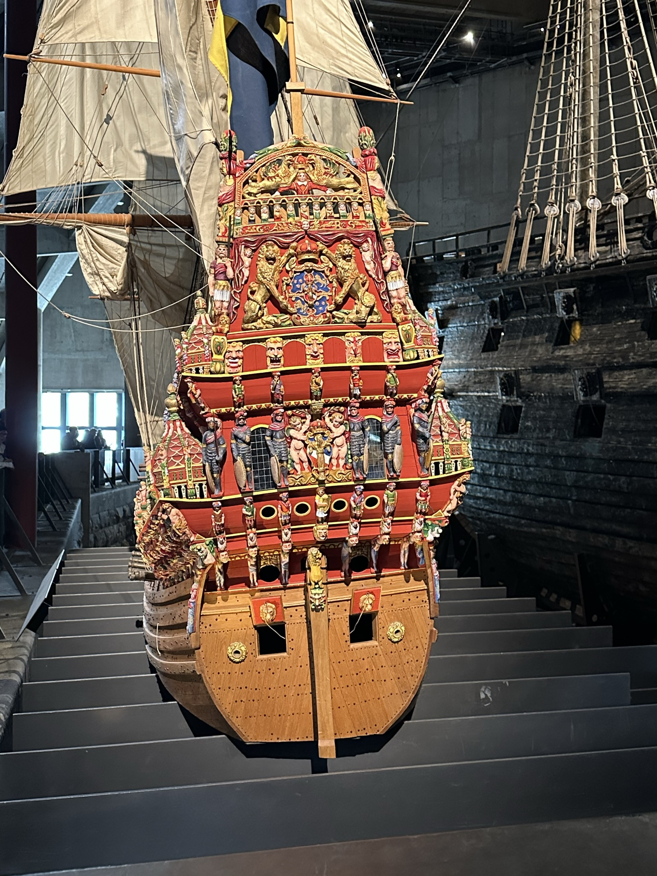
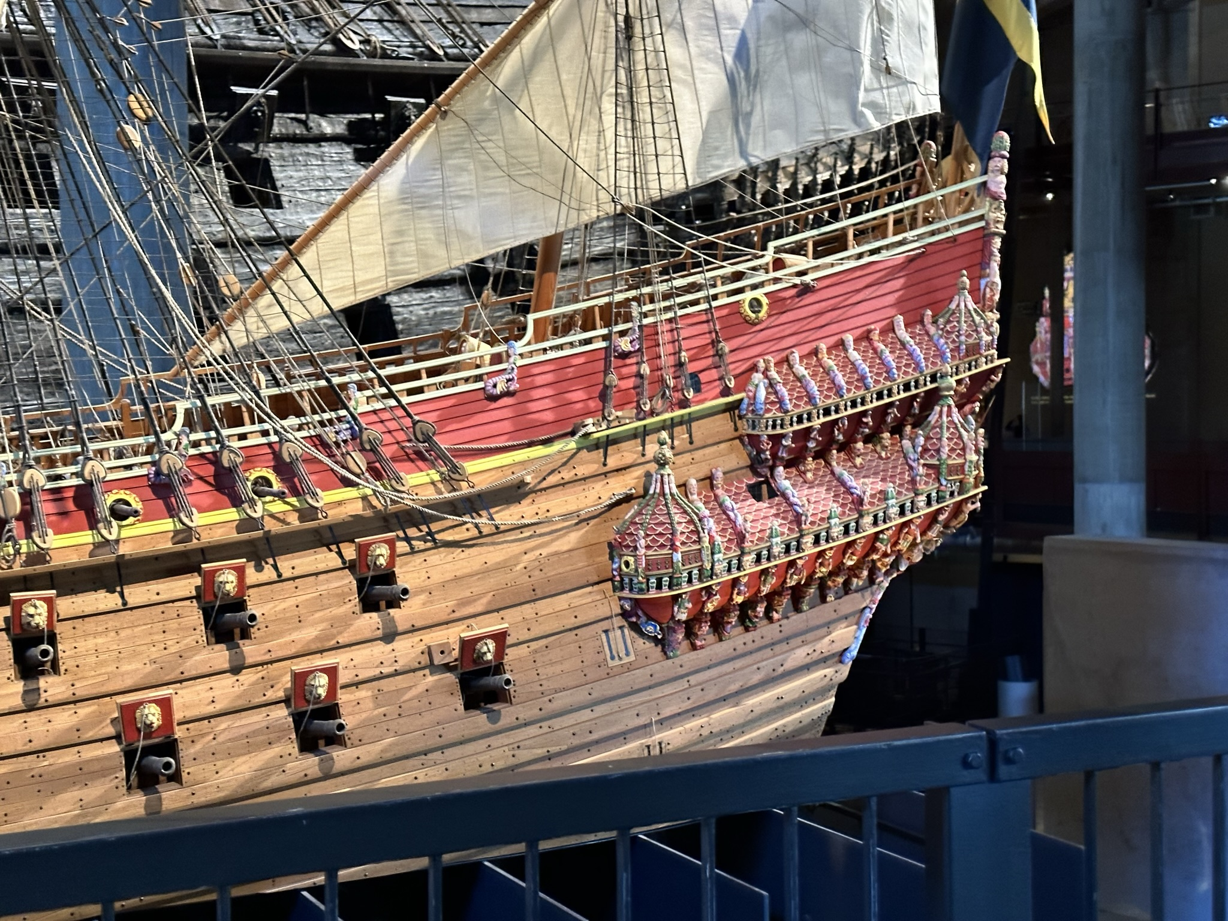
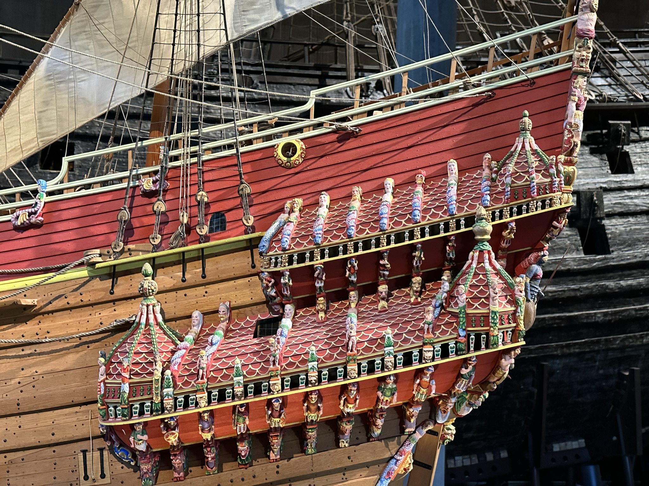
When considering art we must remember that sculpture is created to be both decorative and to transmit messages.
So if using a theme such as Strength and Power look wider, outside of galleries and exhibitions.
These pictures are of a 1:10 replica model and show the colours and elaborate decoration used to convey POWER.

Slide 4
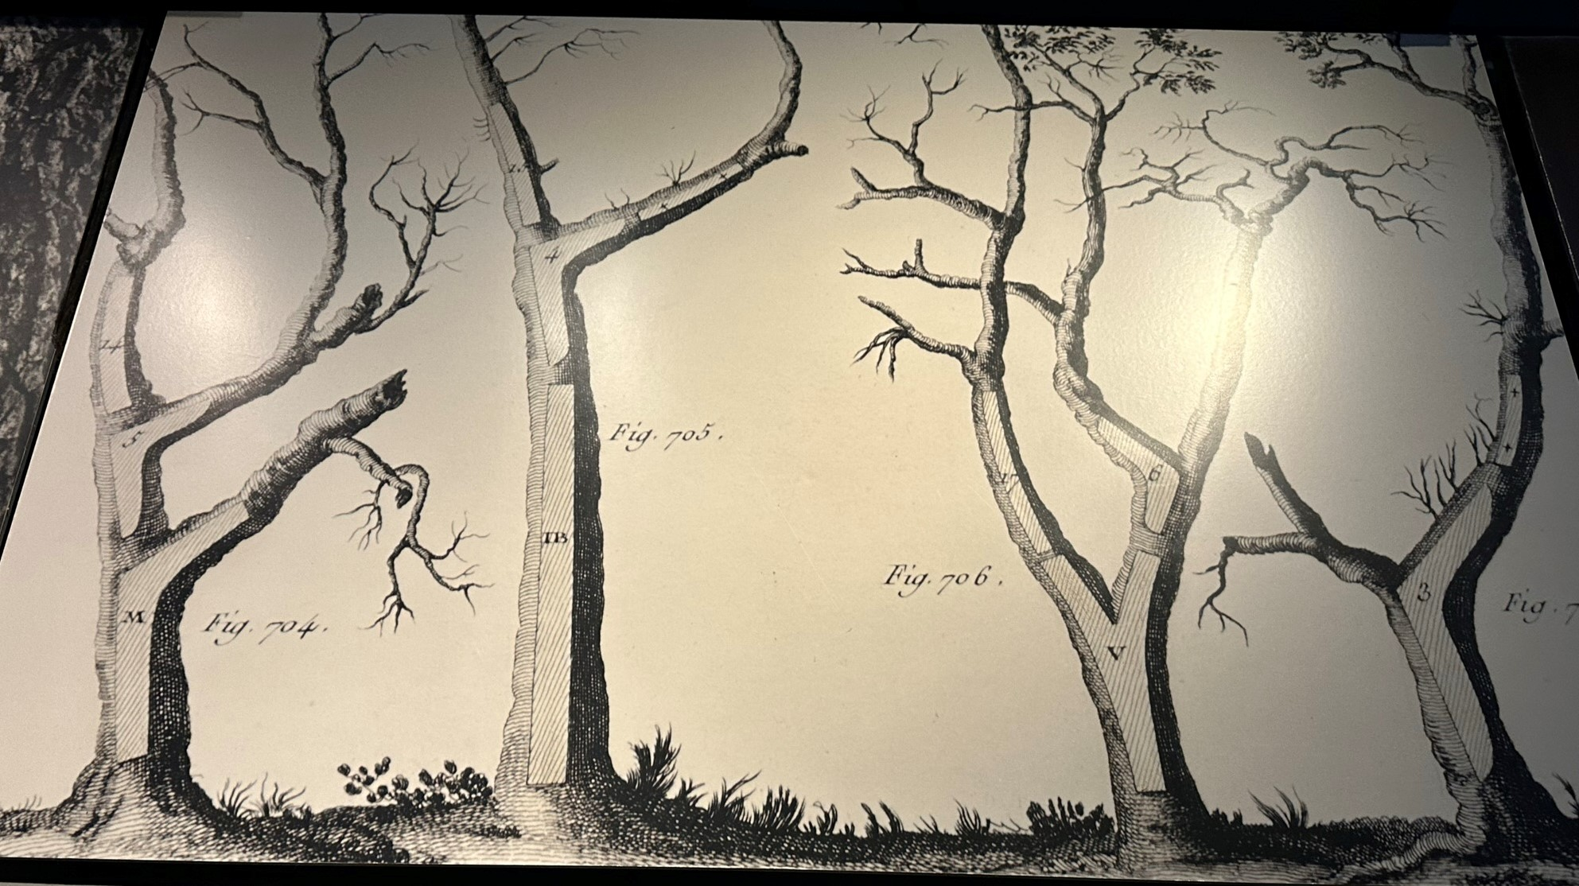
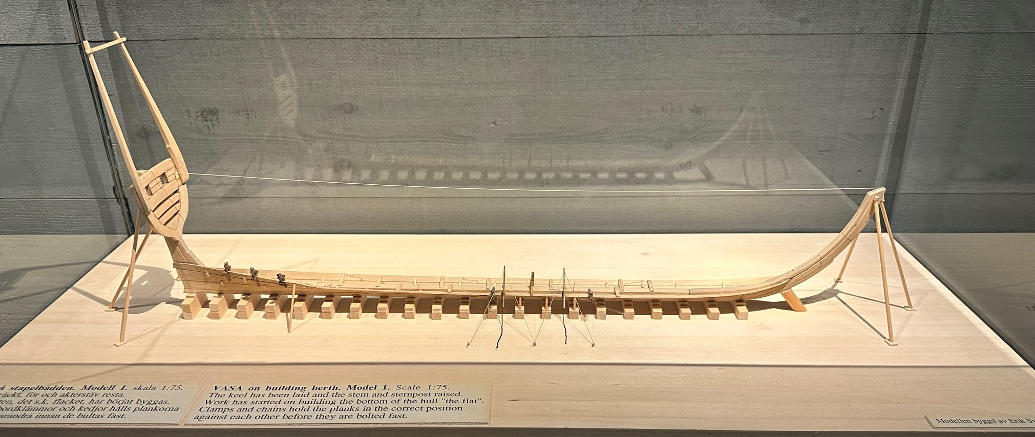
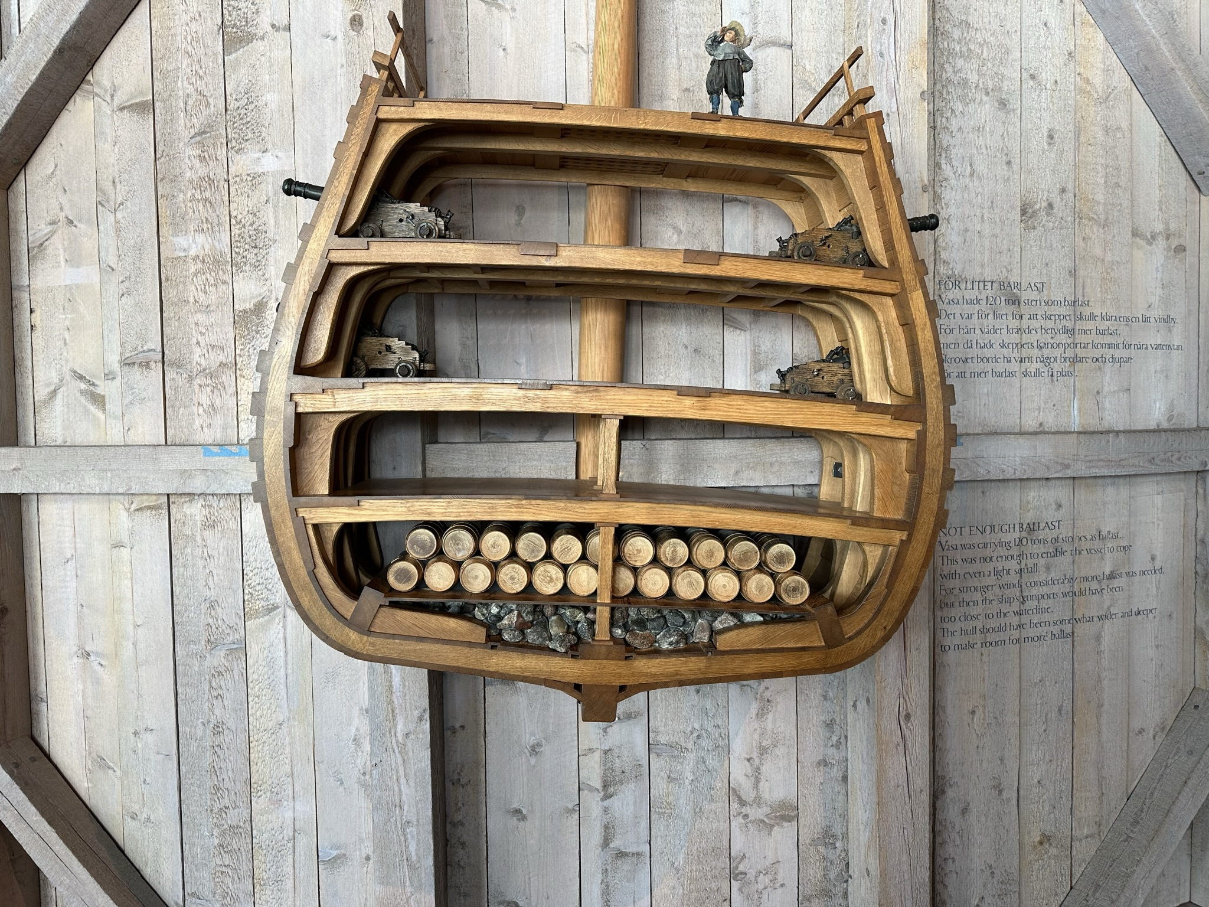
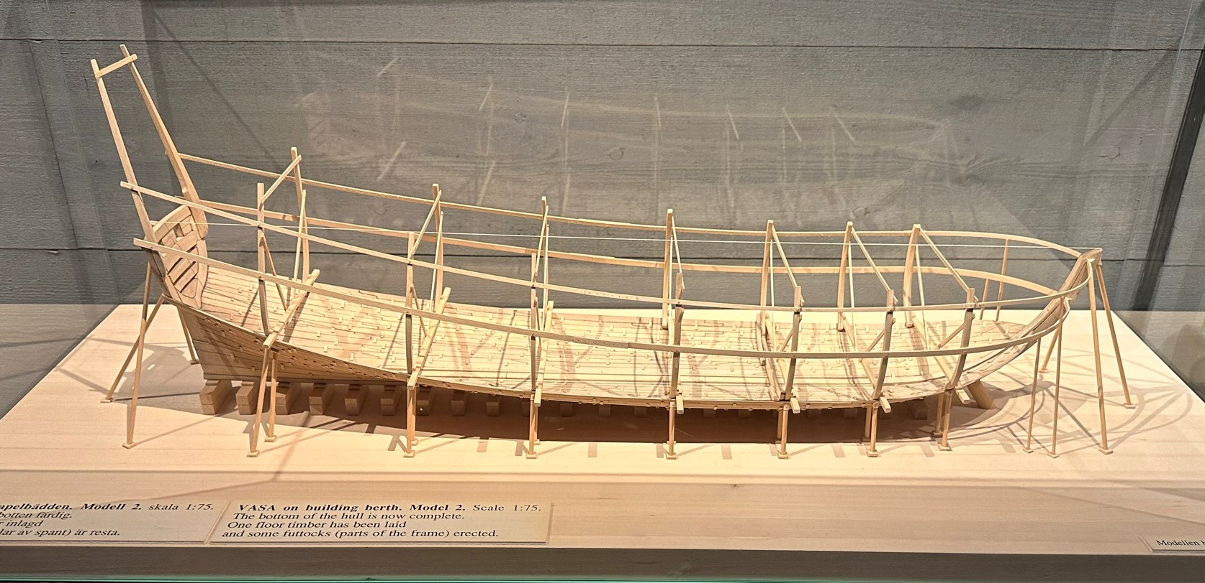
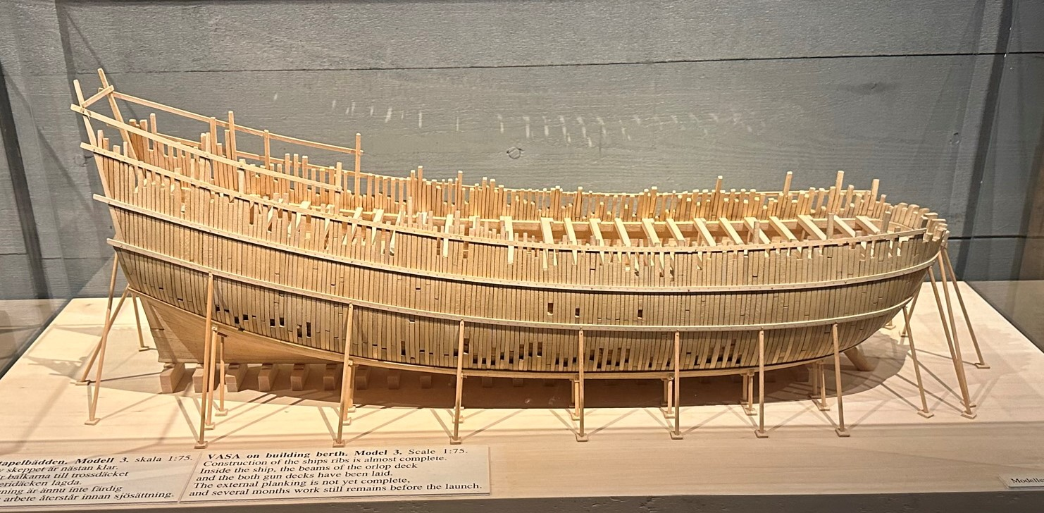
Before looking in depth at some of the sculptures it is worth considering ways that Strength and Power can be portrayed.
STRENGTH – although the vessel sank quickly the strength of the actual construction is testified in the survival over so many years and the way that the structure could be rebuilt. Some interesting links with design and technology.

Slide 5
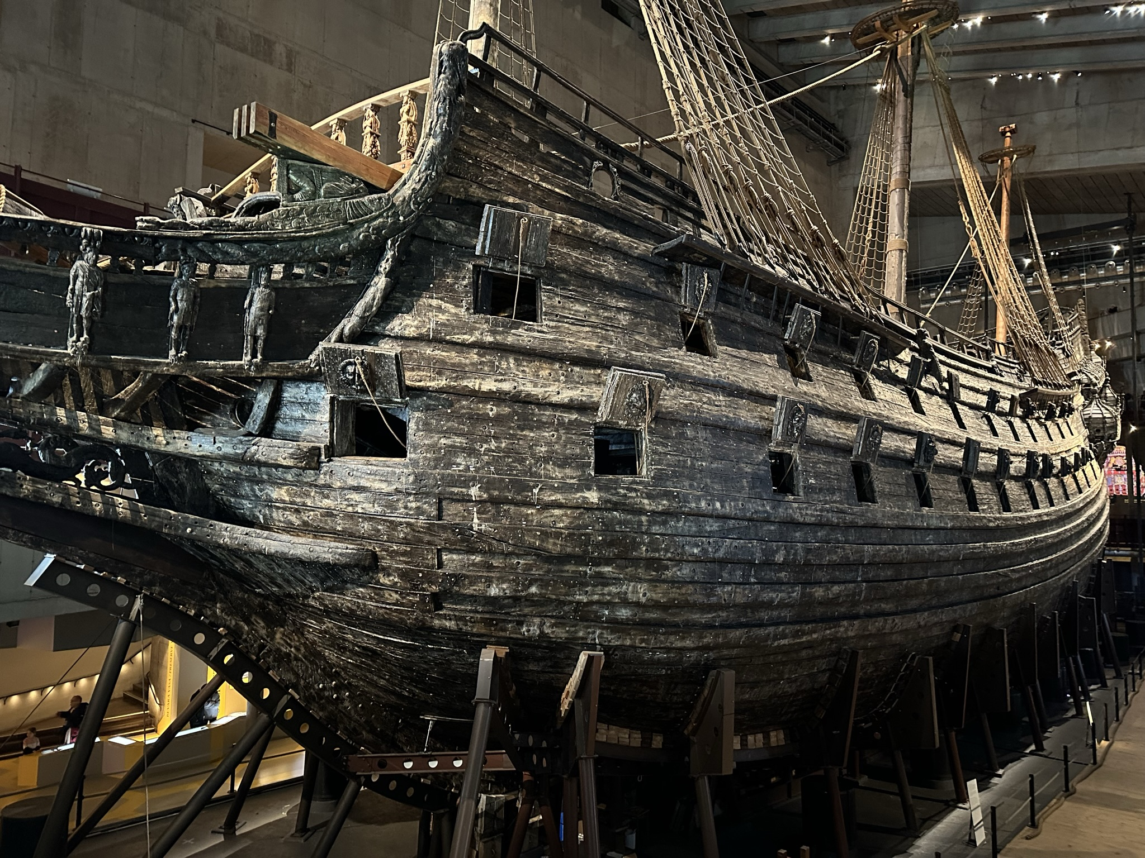
So what may have happened? Did the importance of showing POWER override the actual design of the vessel to stand up to the POWER of the wind and the force of the sea?
It is reported that the ship was too narrow and had insufficient ballast in it’s hold. A rather expensive design fault. These may indicate design elements to consider if making model boats?
This is such a large ship that it is difficult to capture it’s enormity.

Slide 6
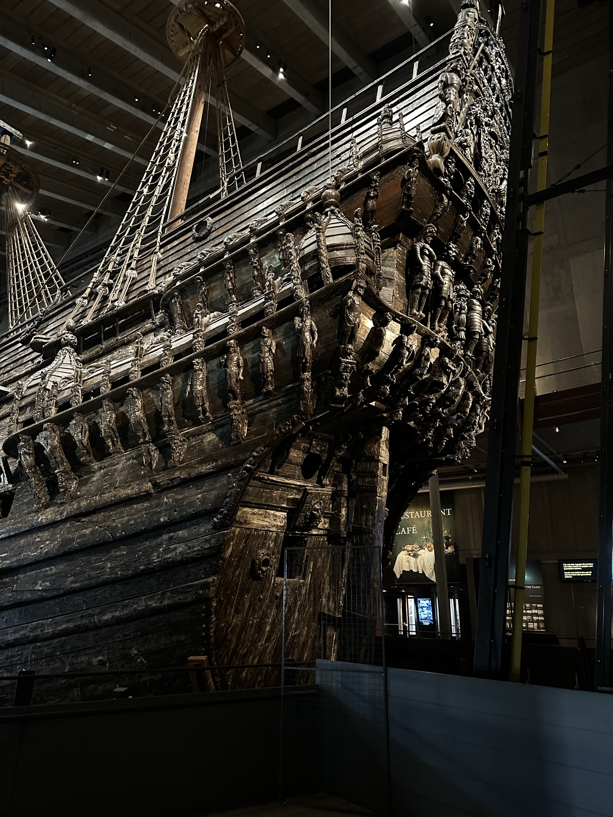
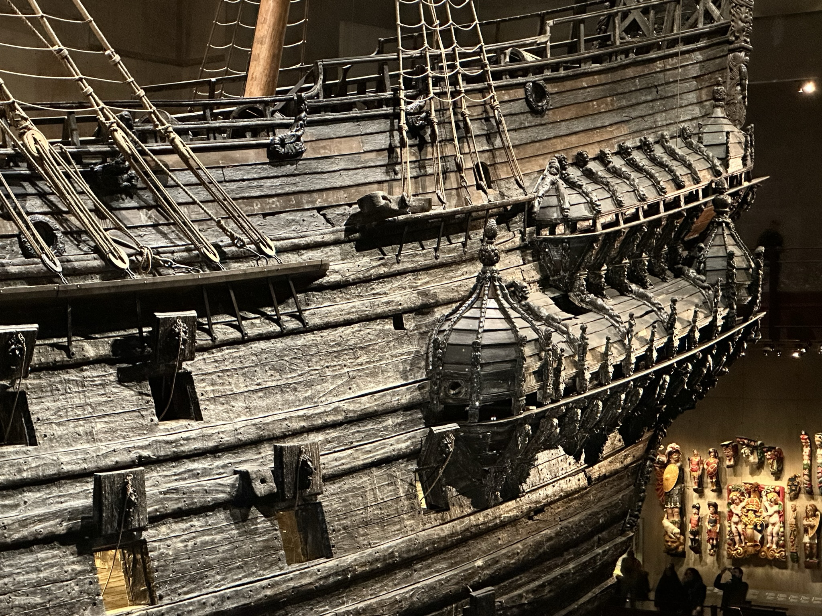
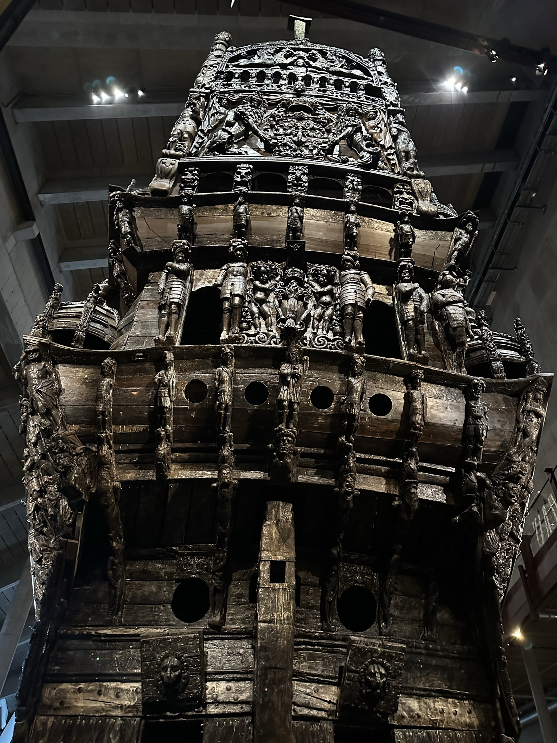

Slide 7
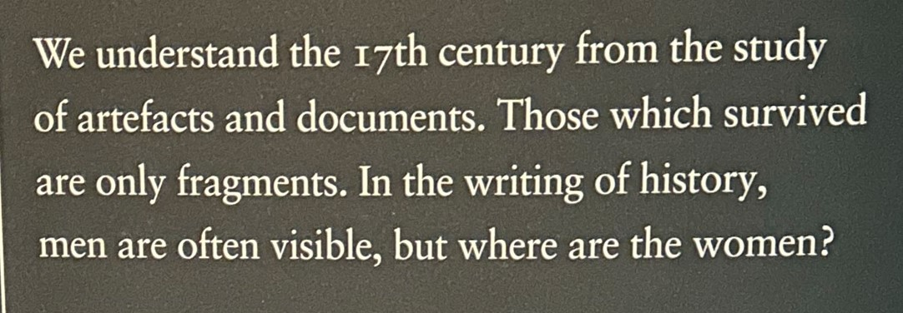
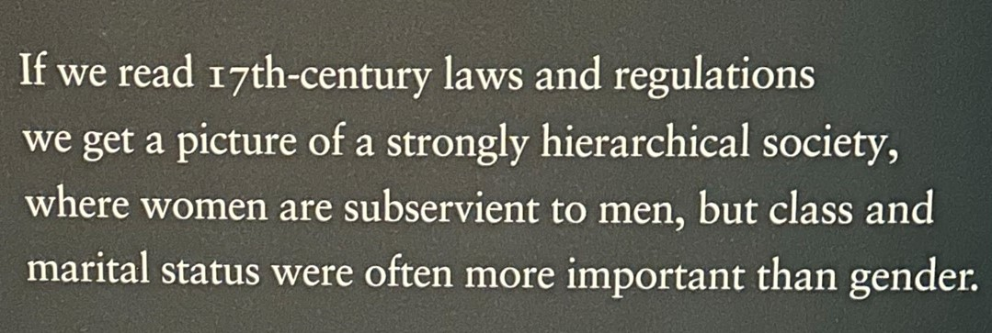
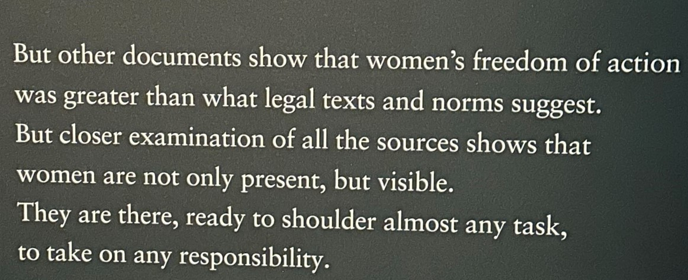
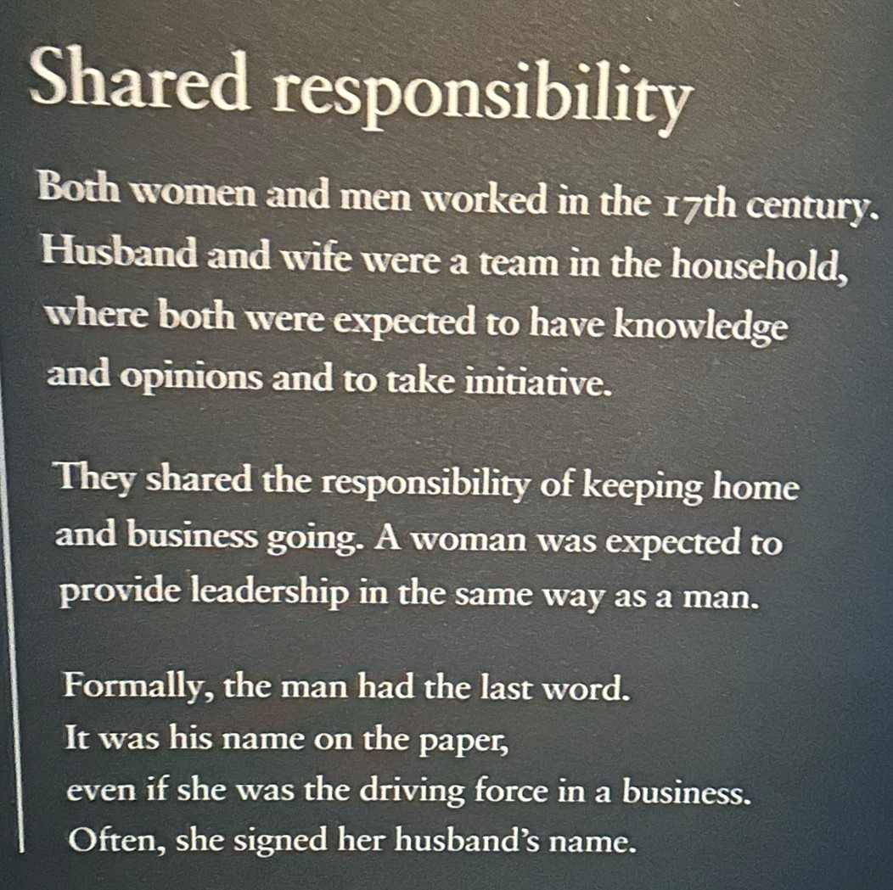
The museum has an exhibition area dedicated to the role of women both at the time the Vasa was built and also their role in it’s construction. These quotes tell a POWERFUL story.
Men were often absent in the 17th century due to war. Women not only had to work on estates and farms but run them. They were often occupied in government services as well as family trades.
Research shows that there were women around Vasa. Vasa was and is not just a male project or male cultural heritage.
The image of women in history is strongly marked by the historical vision of the 19th and 20th centuries. This is why research on women less commonly reaches the public.
Women’s history has traditionally been seen as something to one side of ‘real’ history.
The lack of focus on women’s history has been a greater problem than the lack of sources.

Slide 8
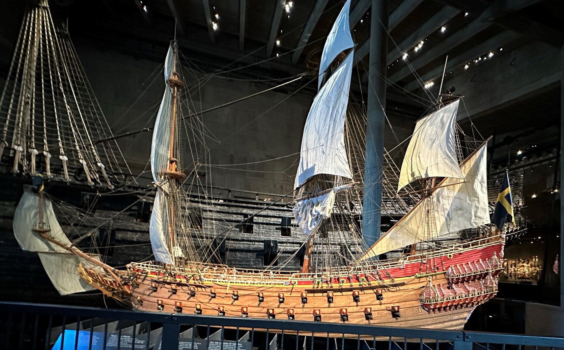
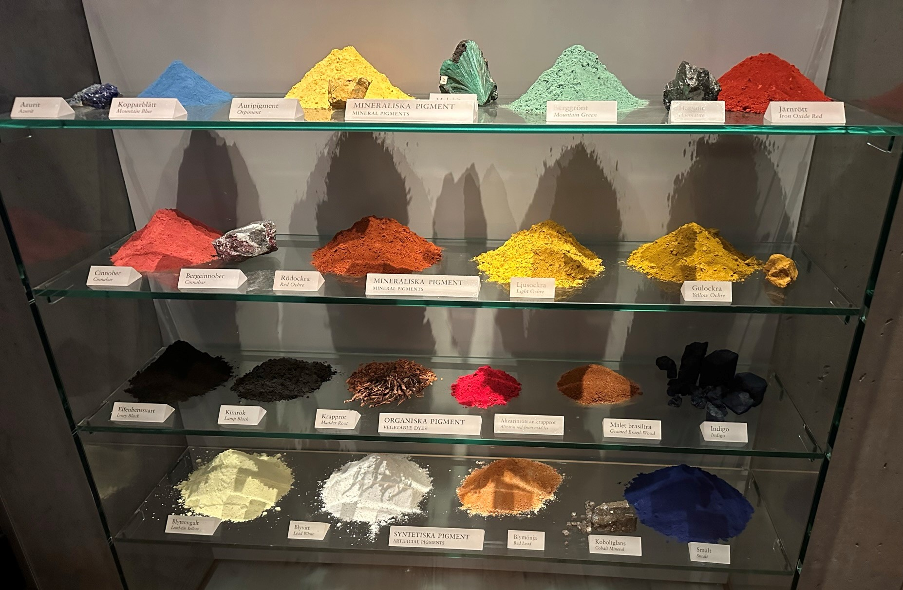
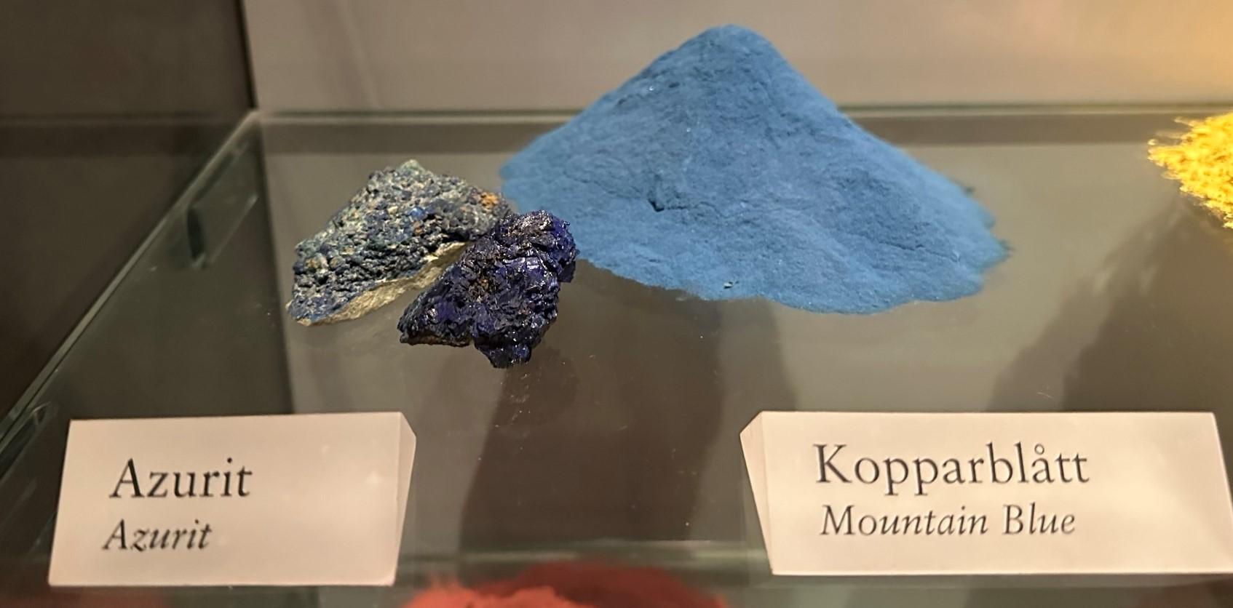
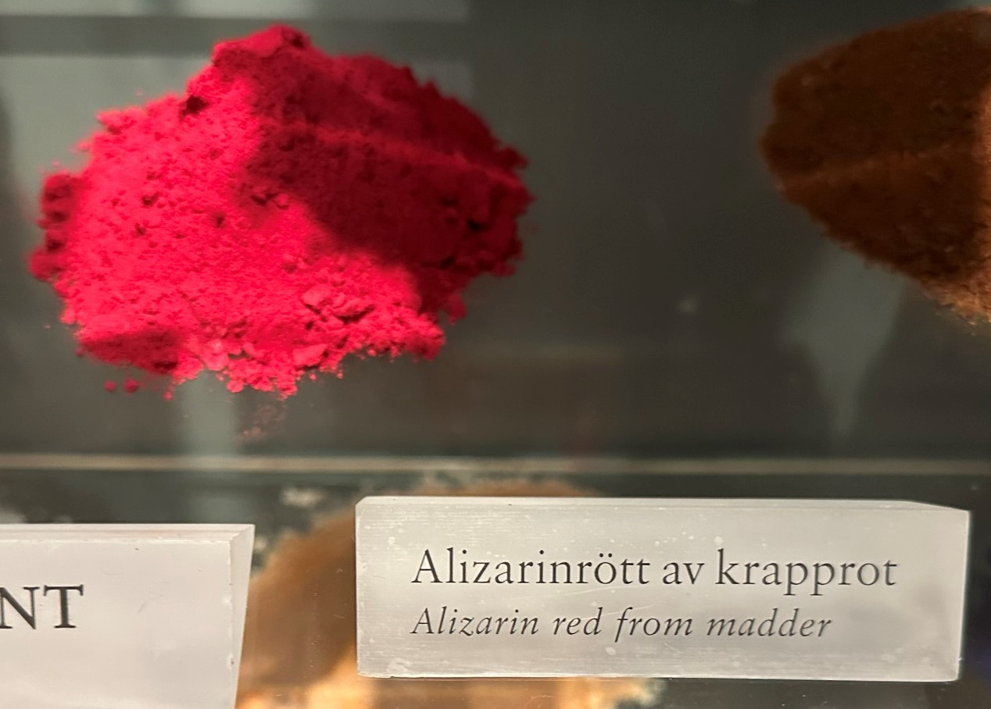
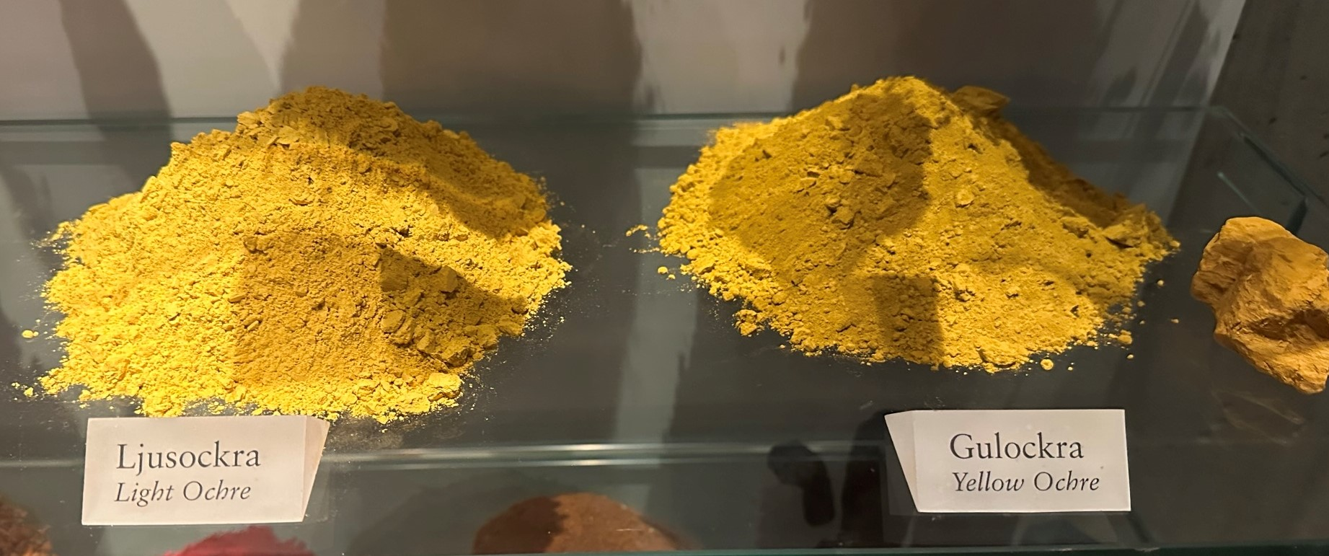
The use of colour to show POWER and STRENGTH -The imagery of POWER.
As well as elaborate designs the predominant colours of Red and Gold were used to show importance through their richness – POWER. From all directions these colours would have been apparent.
This 1:10 model was constructed in the 1980’s but was not coloured until later research was completed on the pigments used. All ten sails are set and all 500 sculptures and carved ornaments are full reproduced at the correct scale.
It took twelve years to research the pigments. Twelve sculptures and over a thousand samples were analysed before reproducing the original decoration.

Slide 9
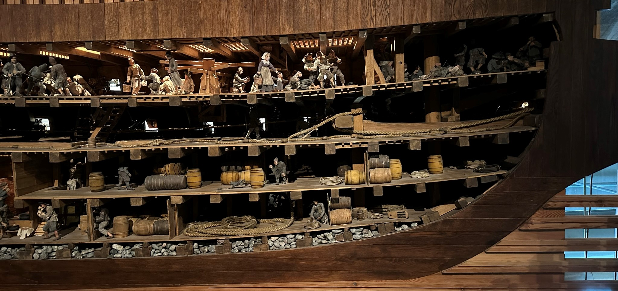
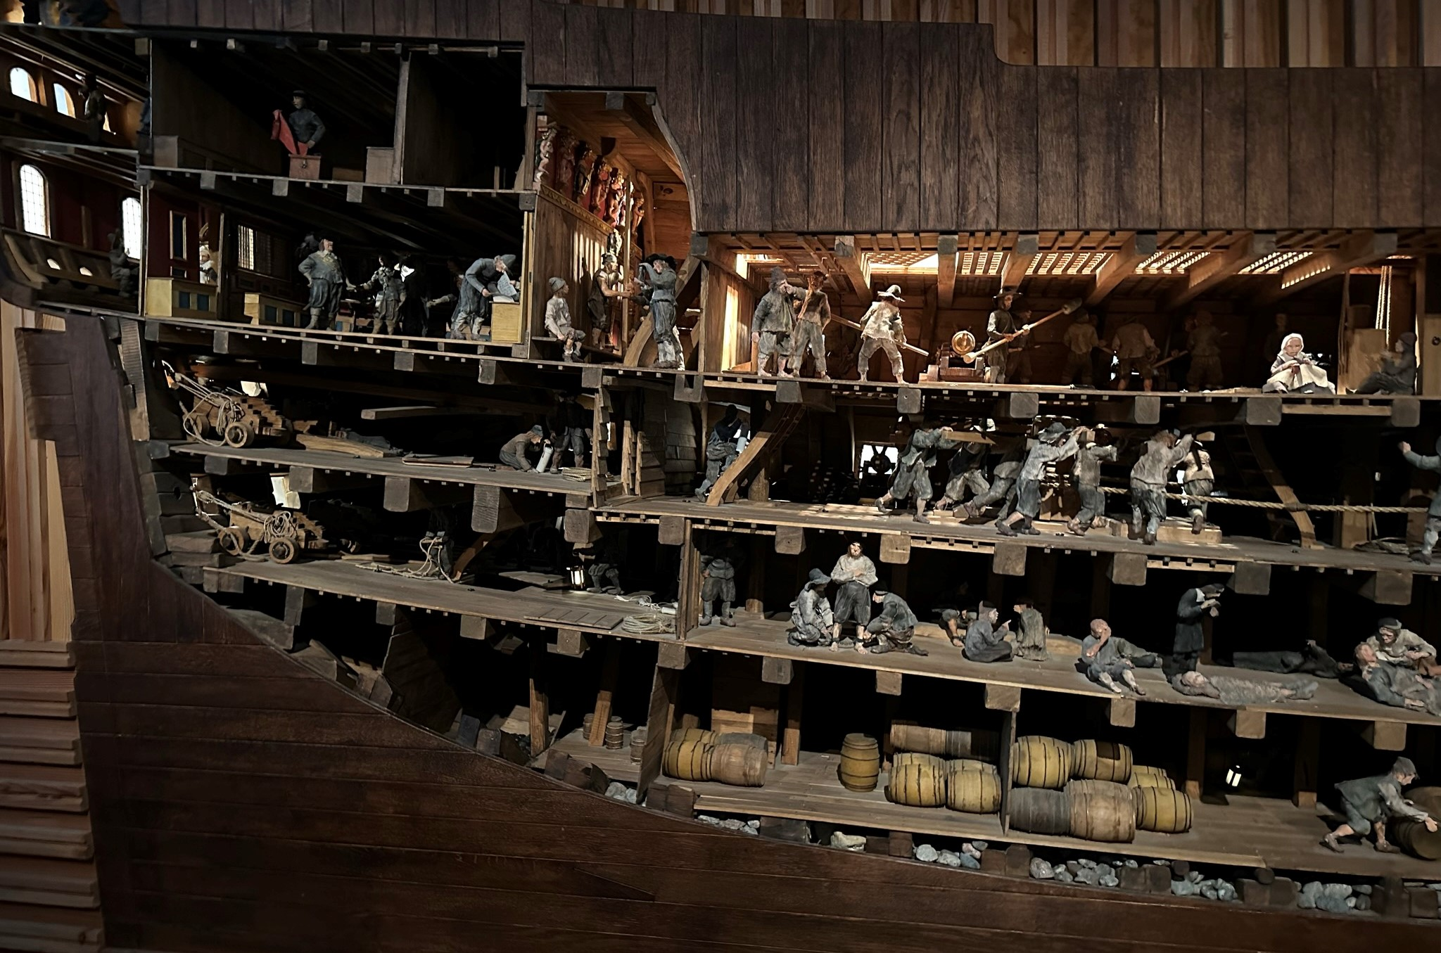
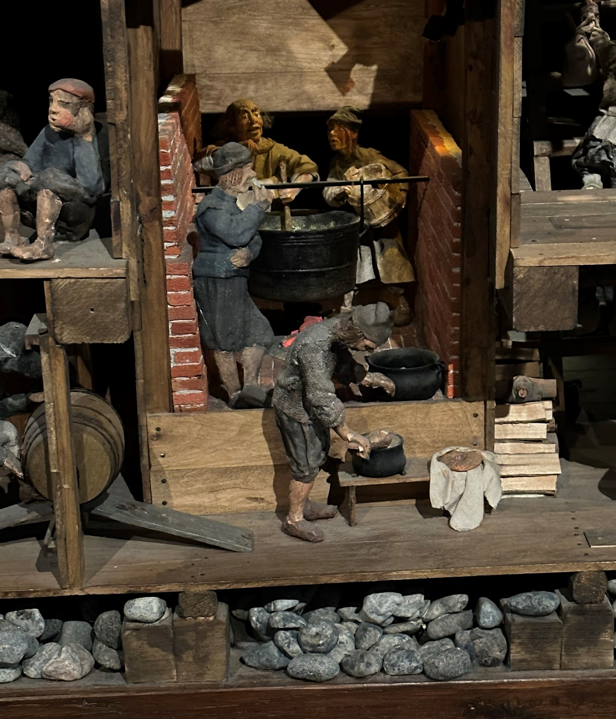
Inside there was certainly a discrepancy between the accommodation and facilities for different ranks. Living conditions were very cramped unless you were in command when the cabin might well have mirrored that of a room inside a rich house. There were also important cabins along the sides which could perhaps have felt very vulnerable in rough seas. Certainly the imagery of POWER was continued in these quarters.
All the food was cooked below decks in a special brick lined room to prevent timbers catching light.

Slide 10
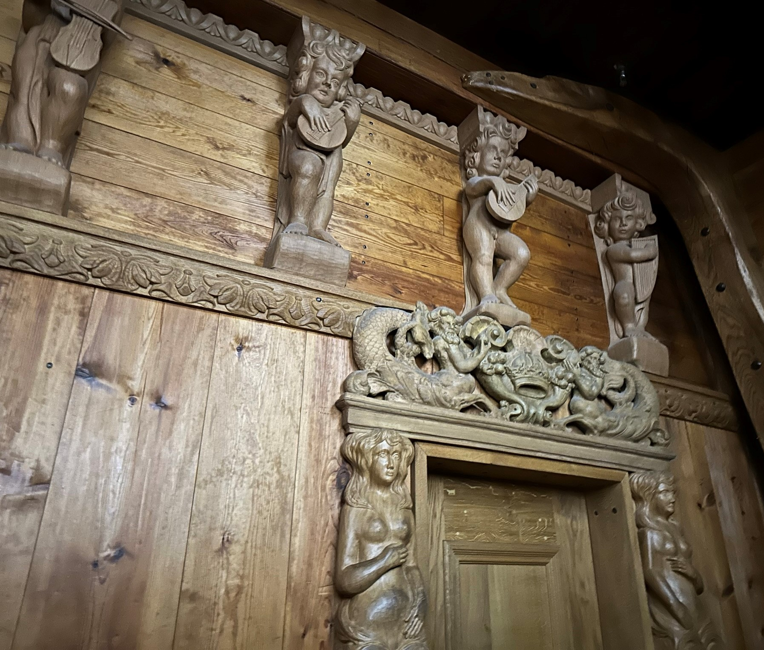
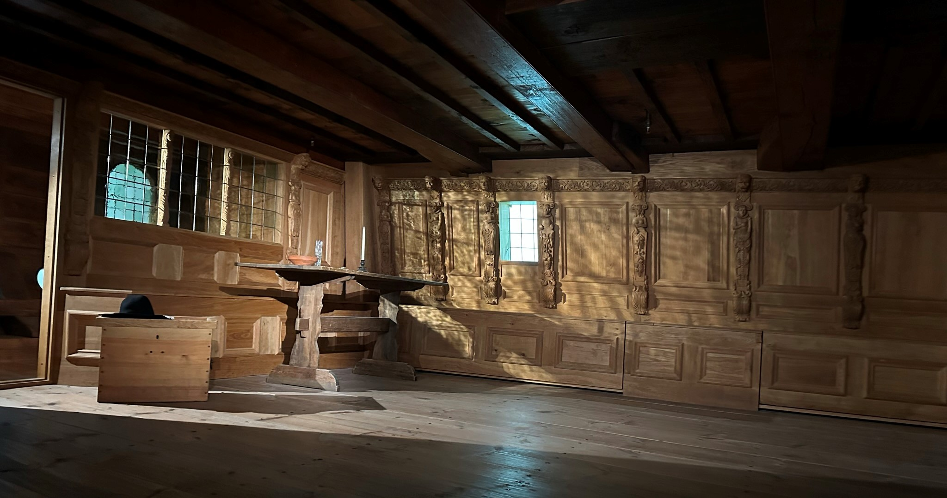
Side berths
Two chamber pots were found amongst the wreckage for use in these living quarters. Otherwise there were two toilets for the entire rest of the crew!

Slide 11
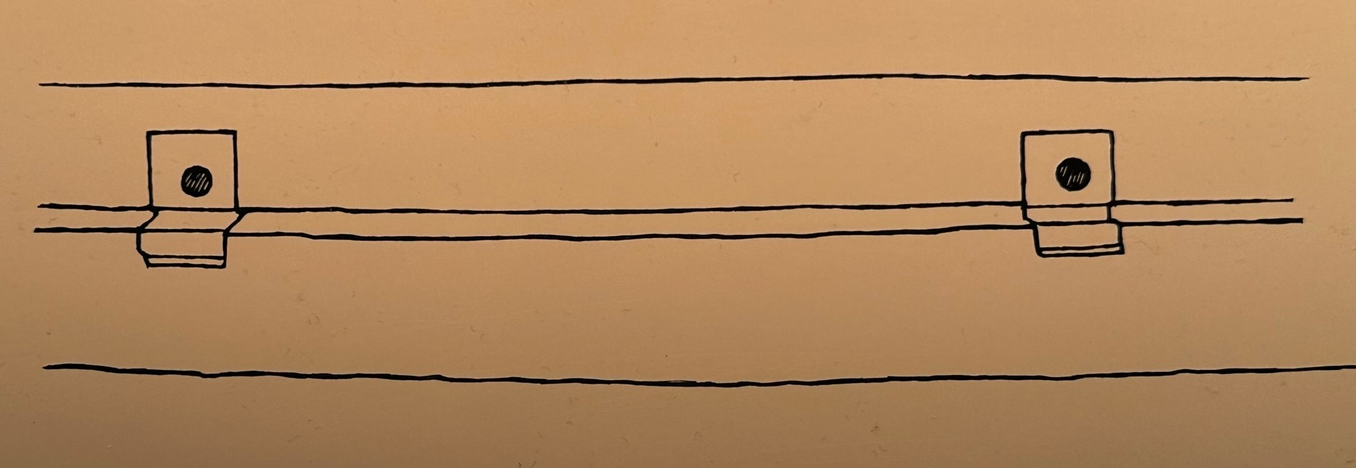
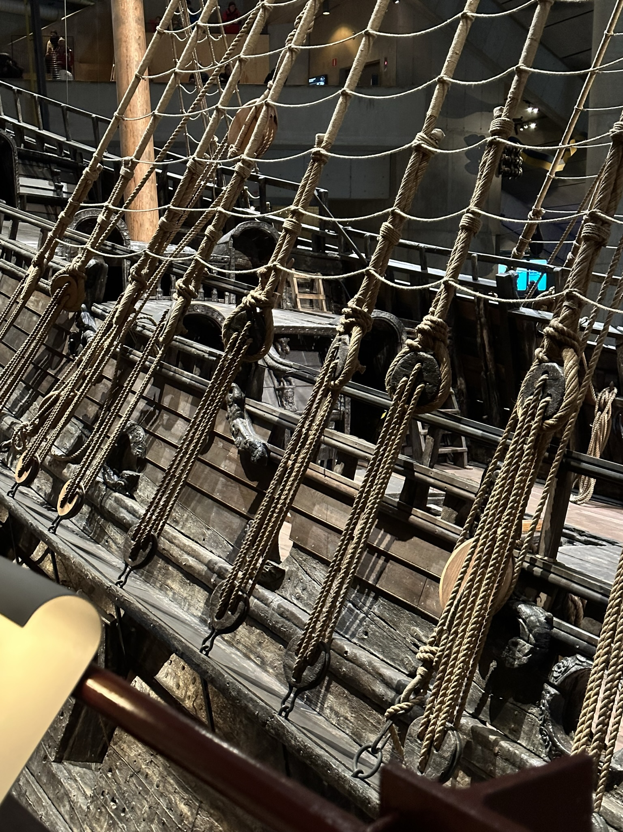
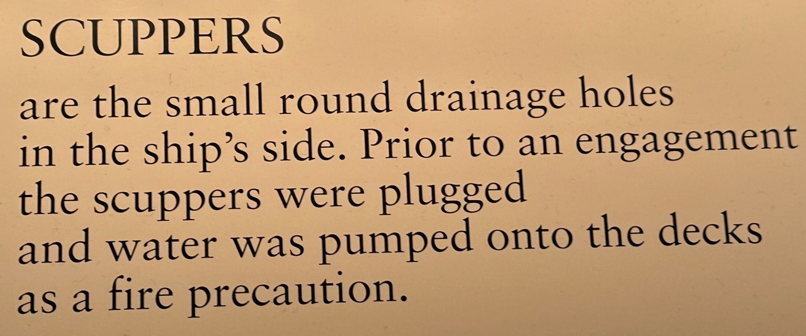
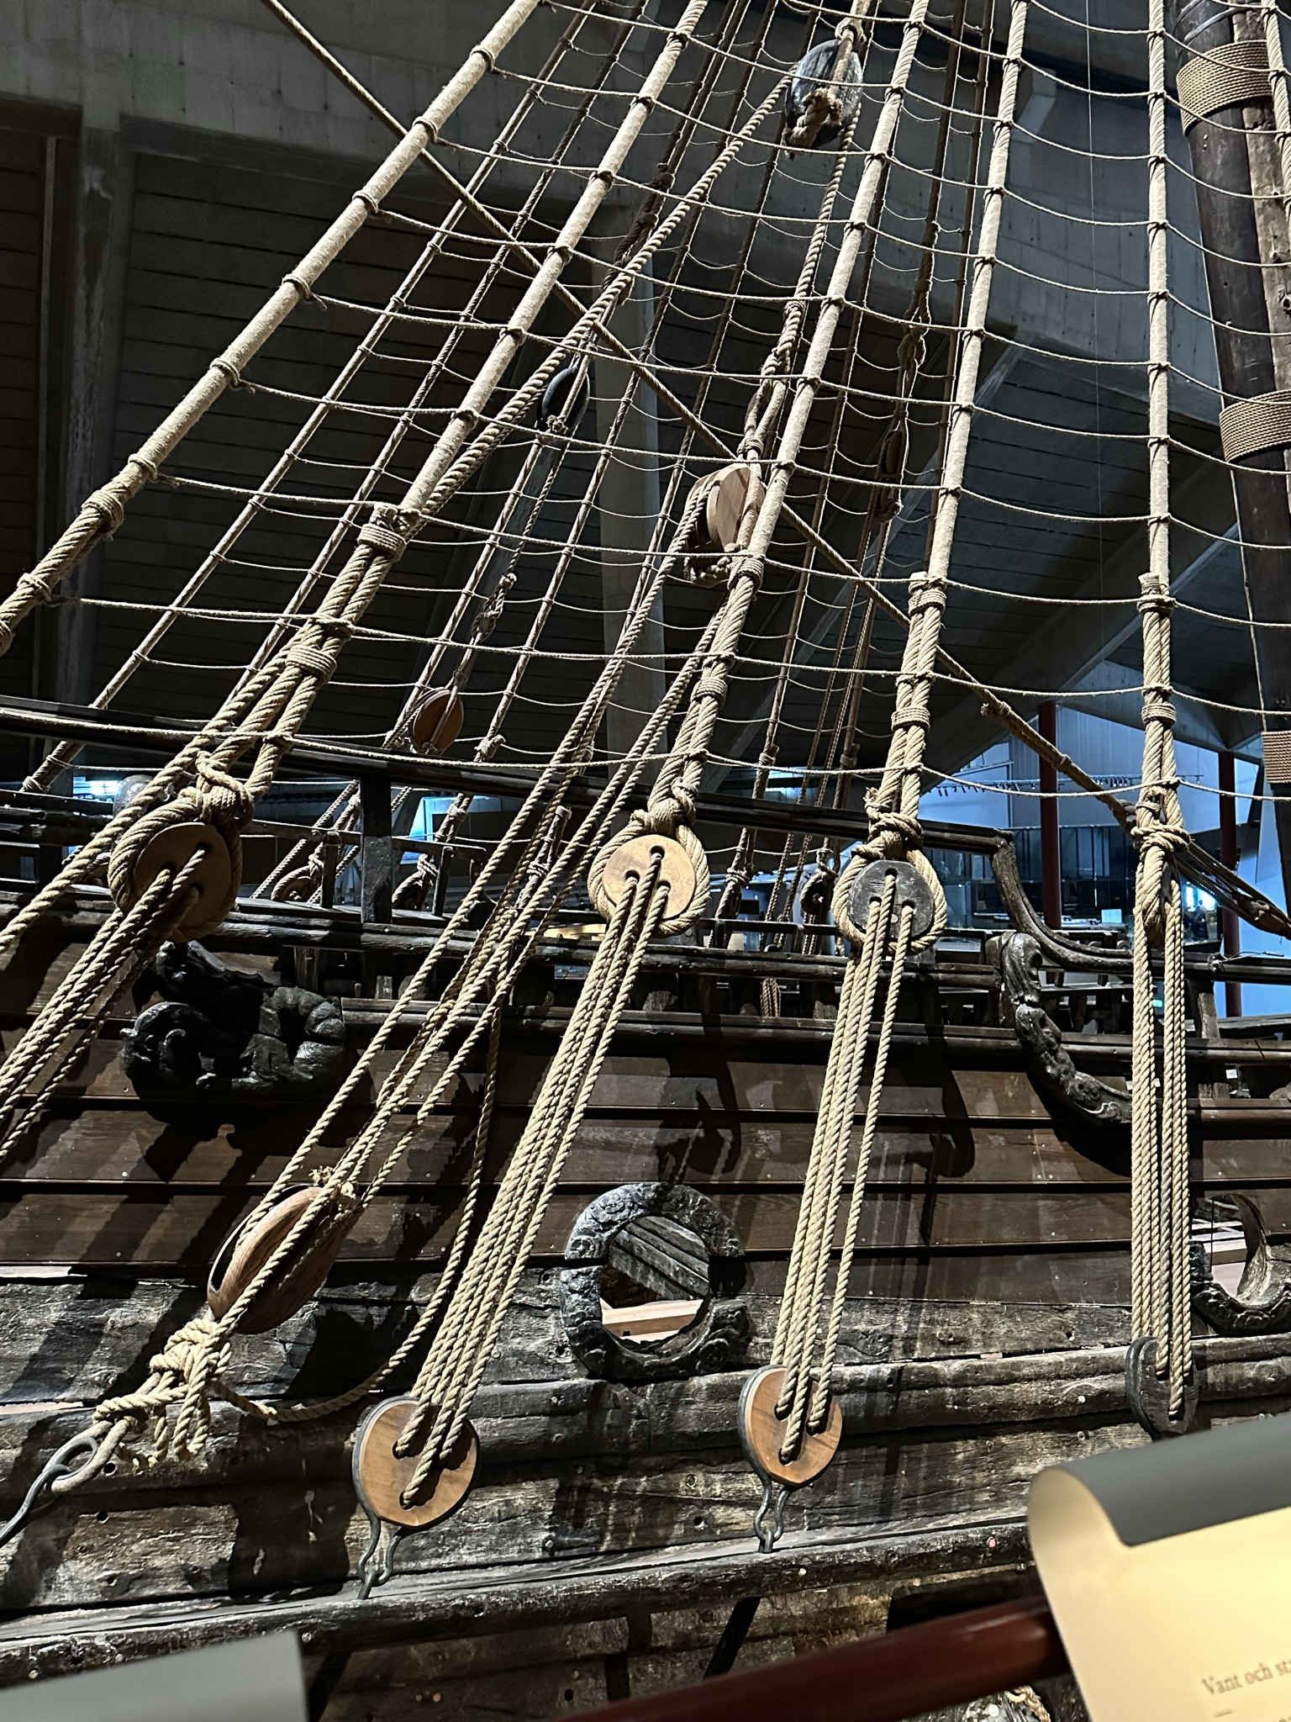
Not exactly artistic but certainly an example of craftsmanship for a purpose. These pulley systems would still have needed a great deal of STRENGTH to hoist the sails and side netting. A great link to science.
The POWER of language.
The word scuppered- to cause something to stop or fail / or to sink deliberately (scuttle)

Slide 12
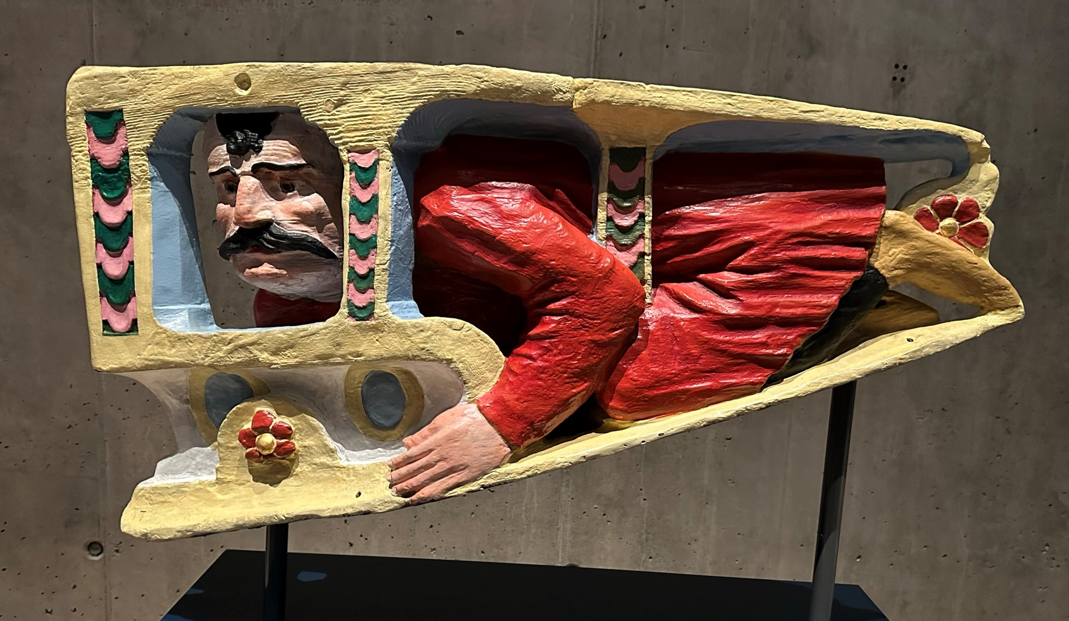
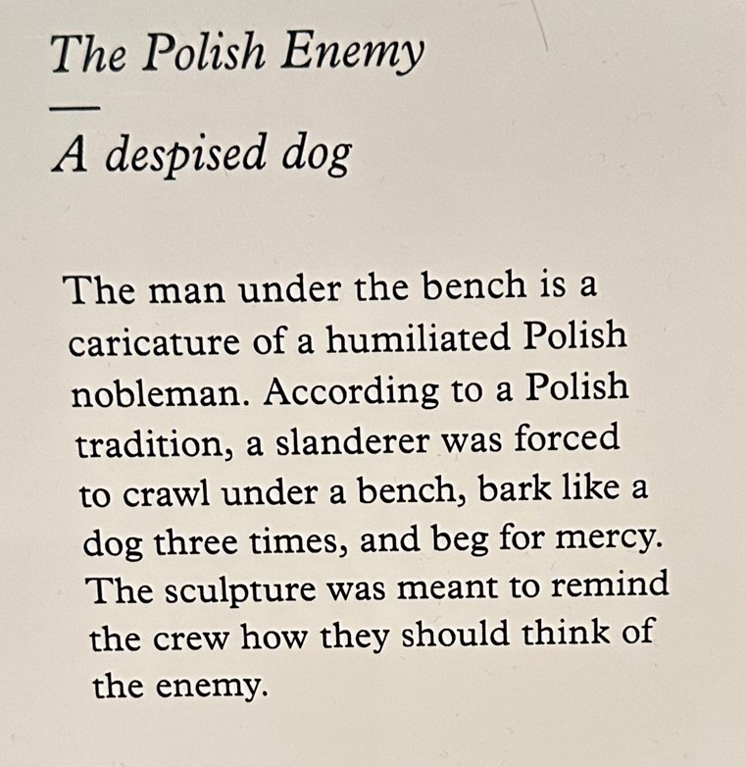
It was important to reinforce to the crew that they must show a front of POWER over their enemies. This sculpture was designed to remind them of this!

Slide 13
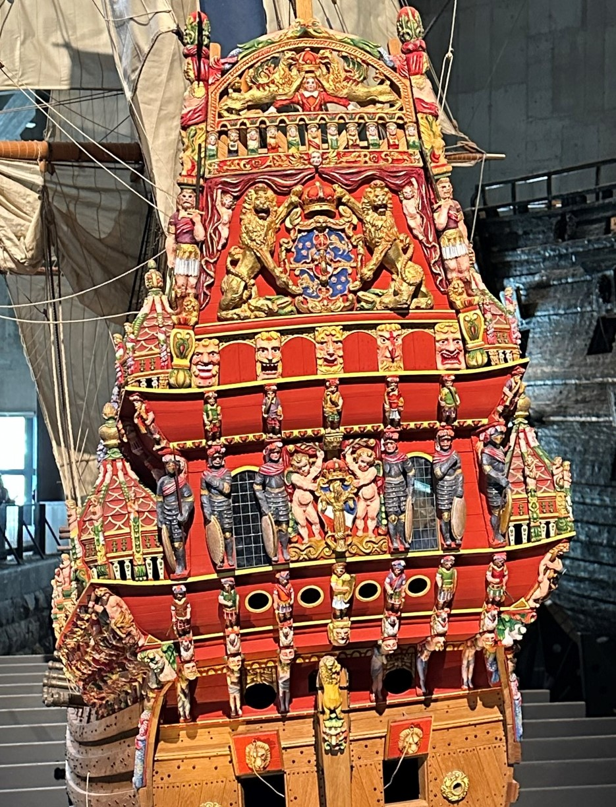
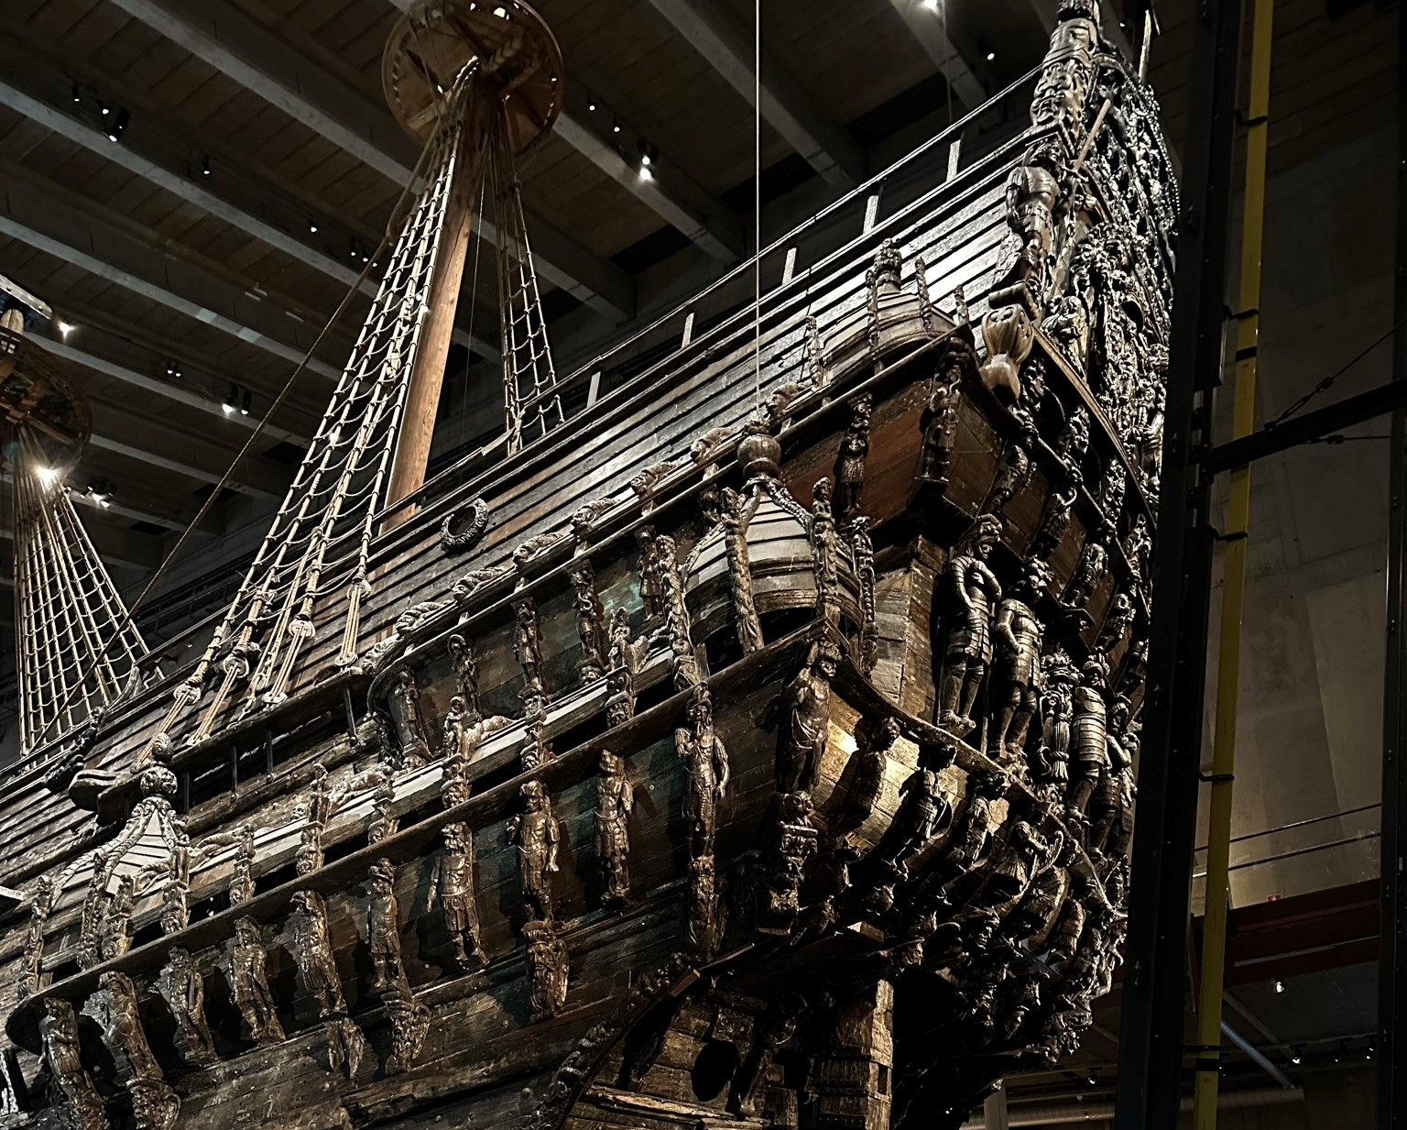
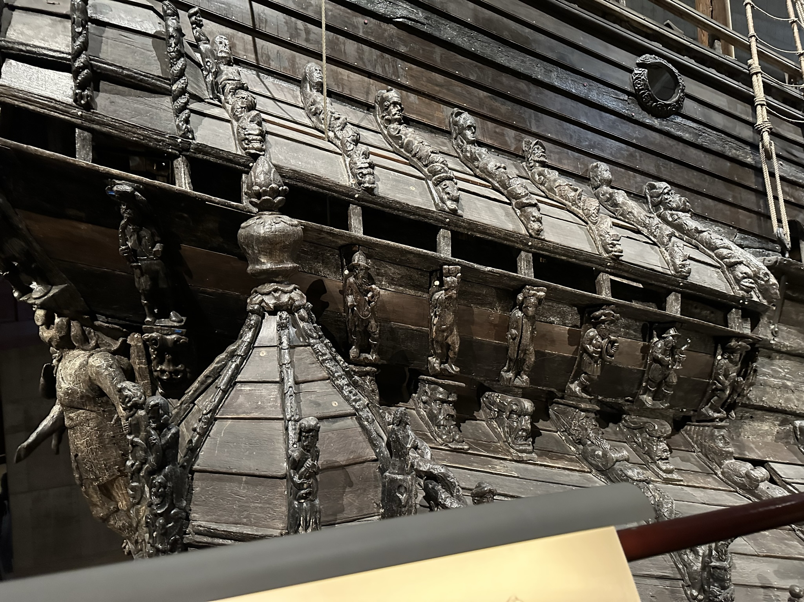
Of the 500 sculptures and engraved patterns many are symbols to represent POWER of Sweden at this time and the STRENGTH and POWER of the monarchy.
The royal coat of arms and that of the ship are featured in this view but note also the caricatured faces to
warn off the enemy!

Slide 14
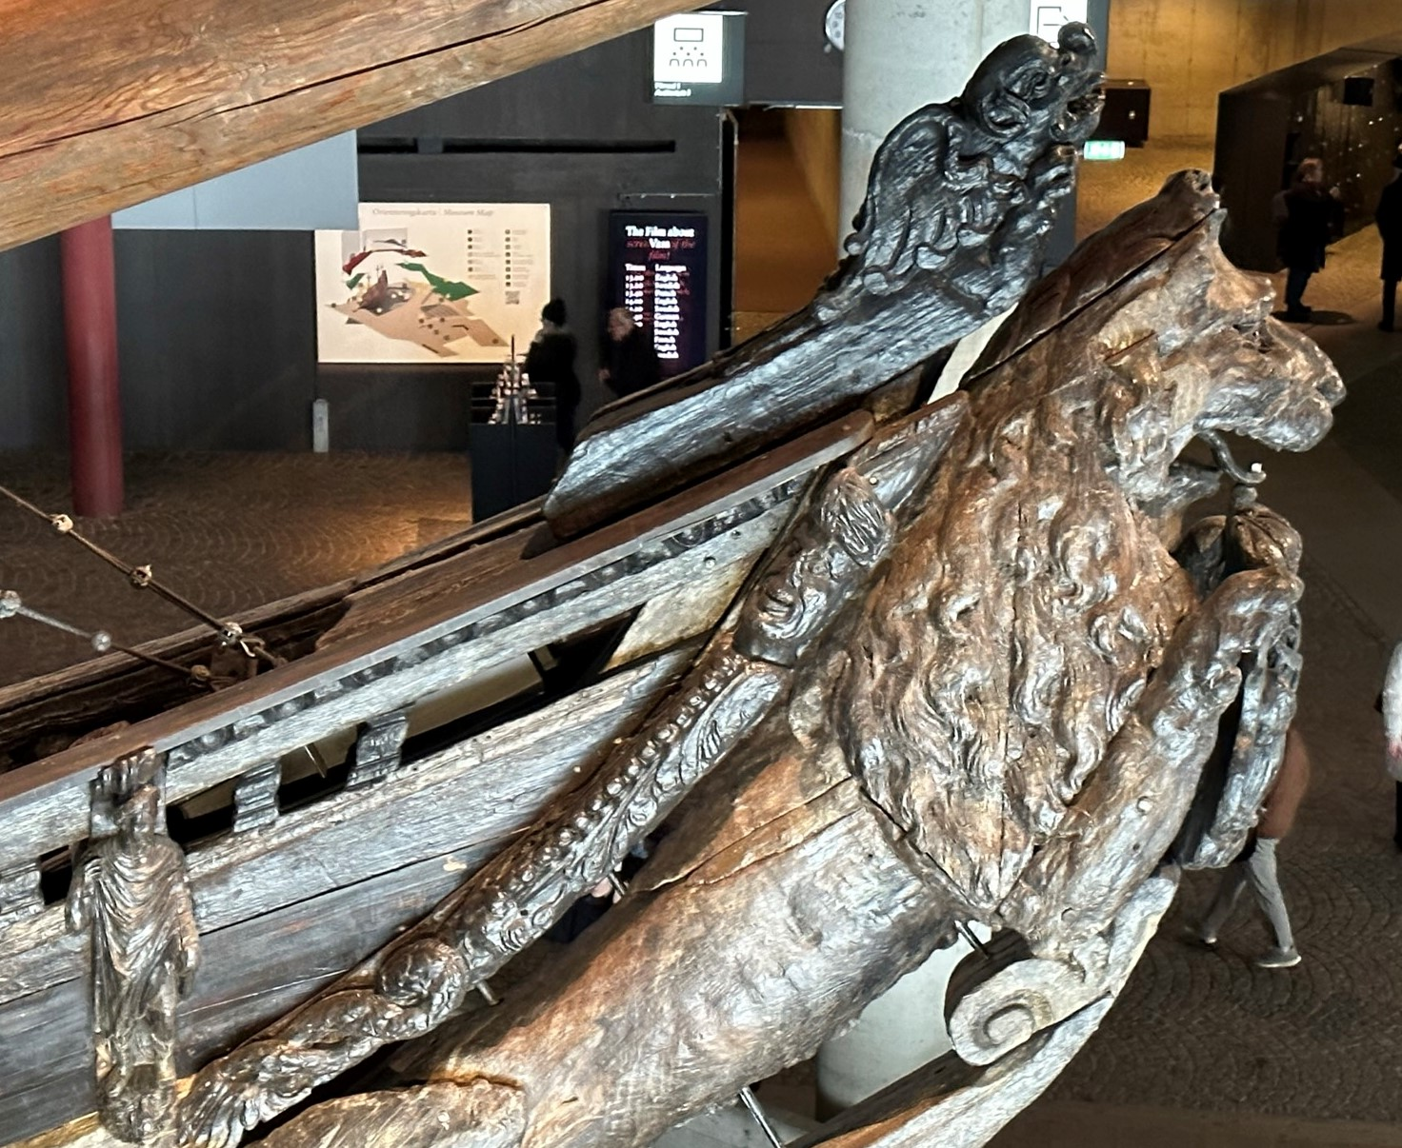
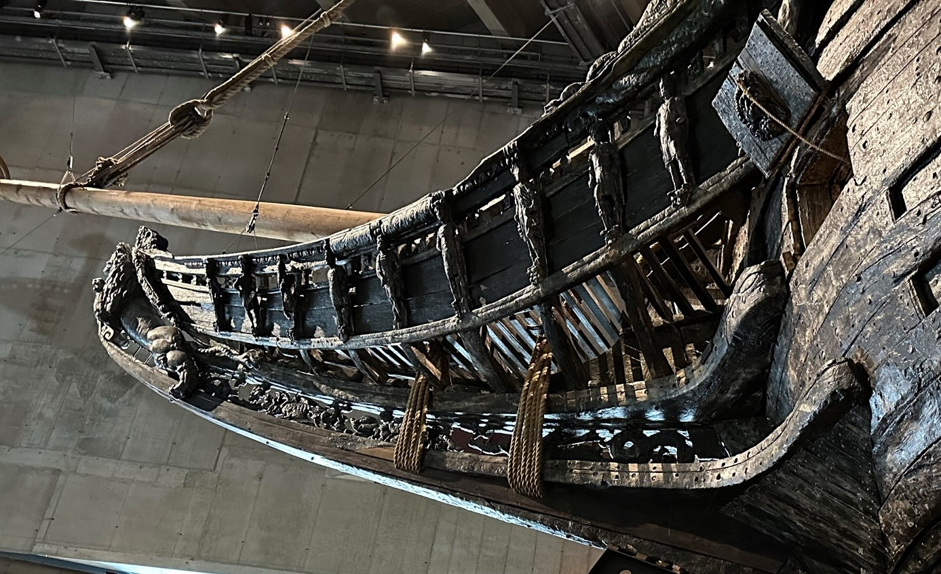
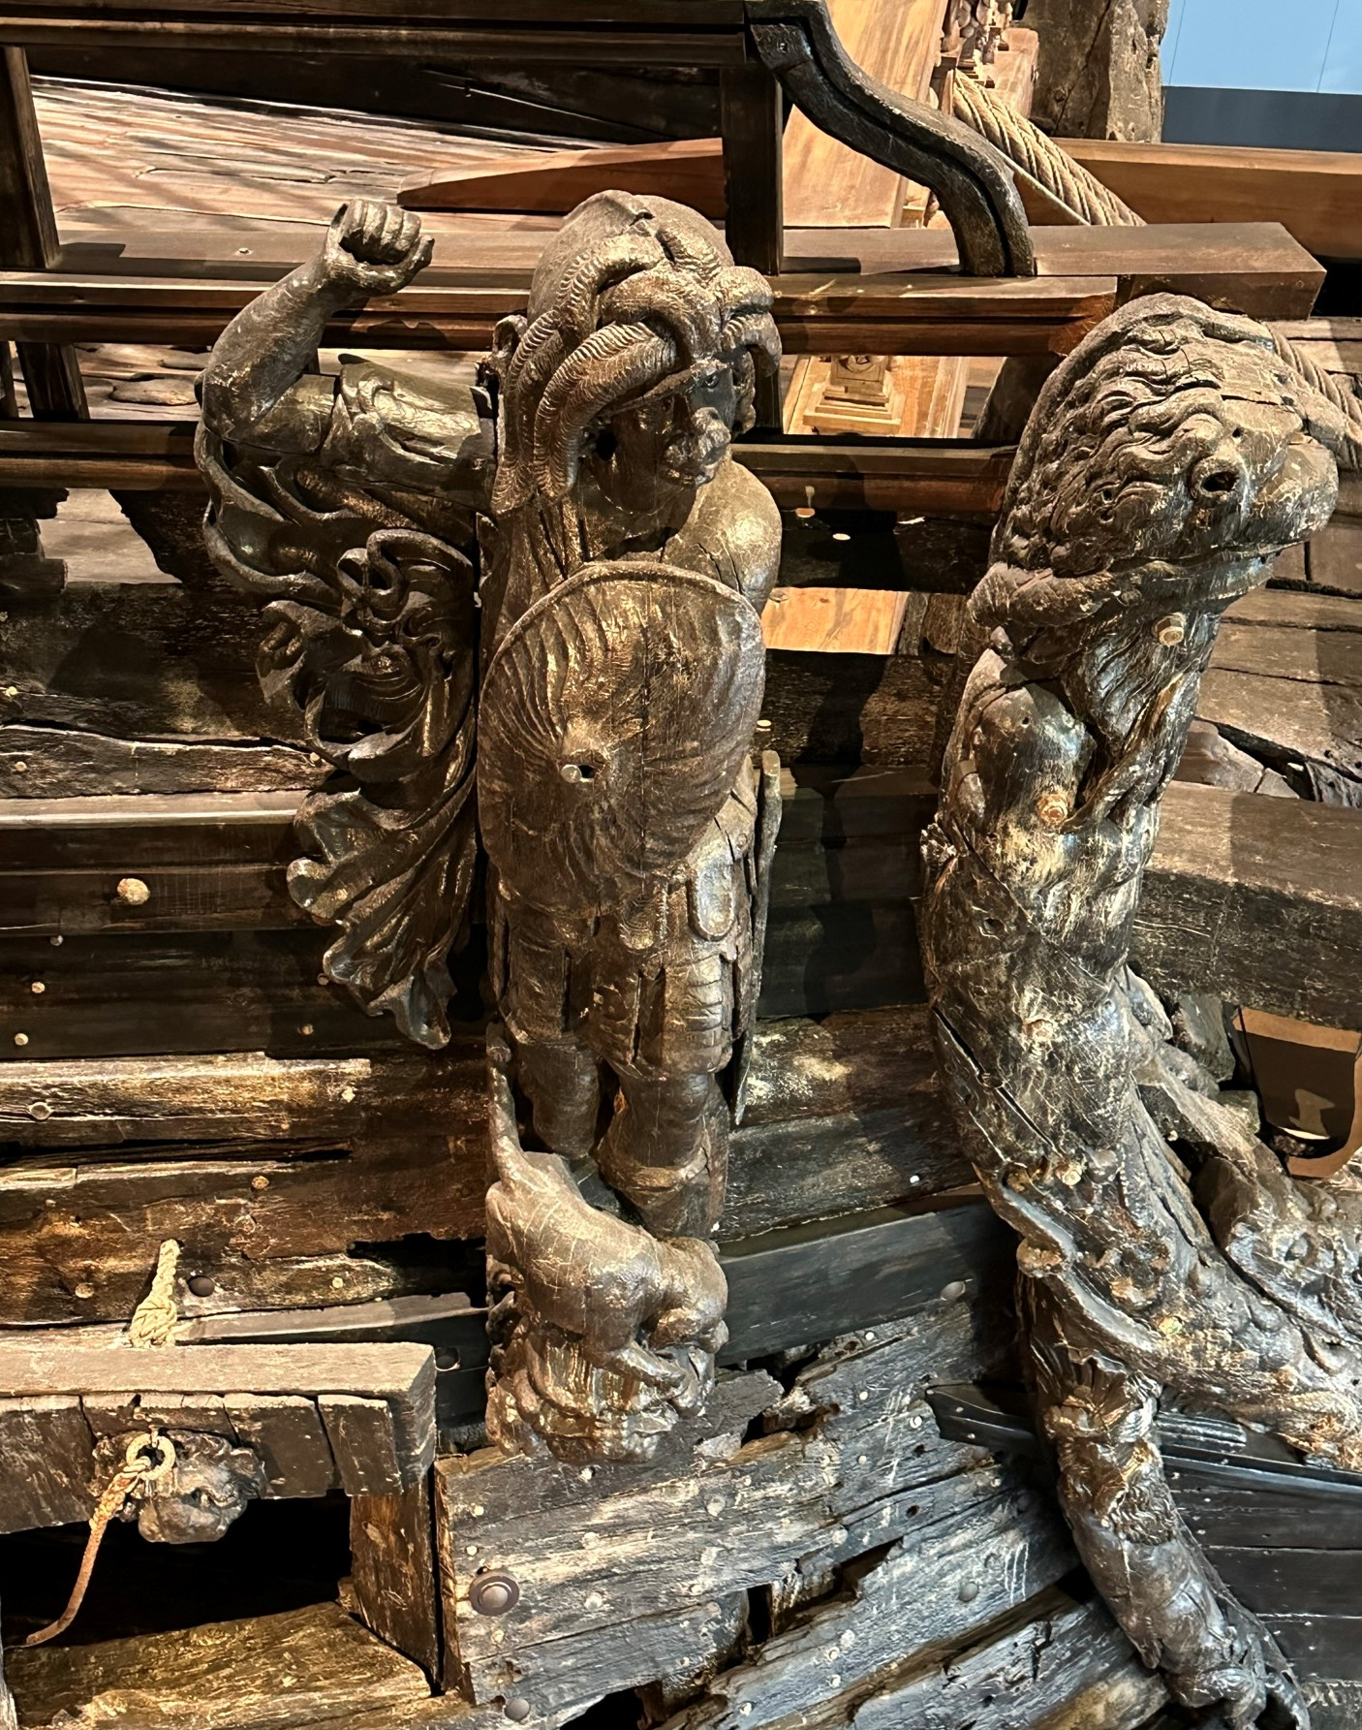
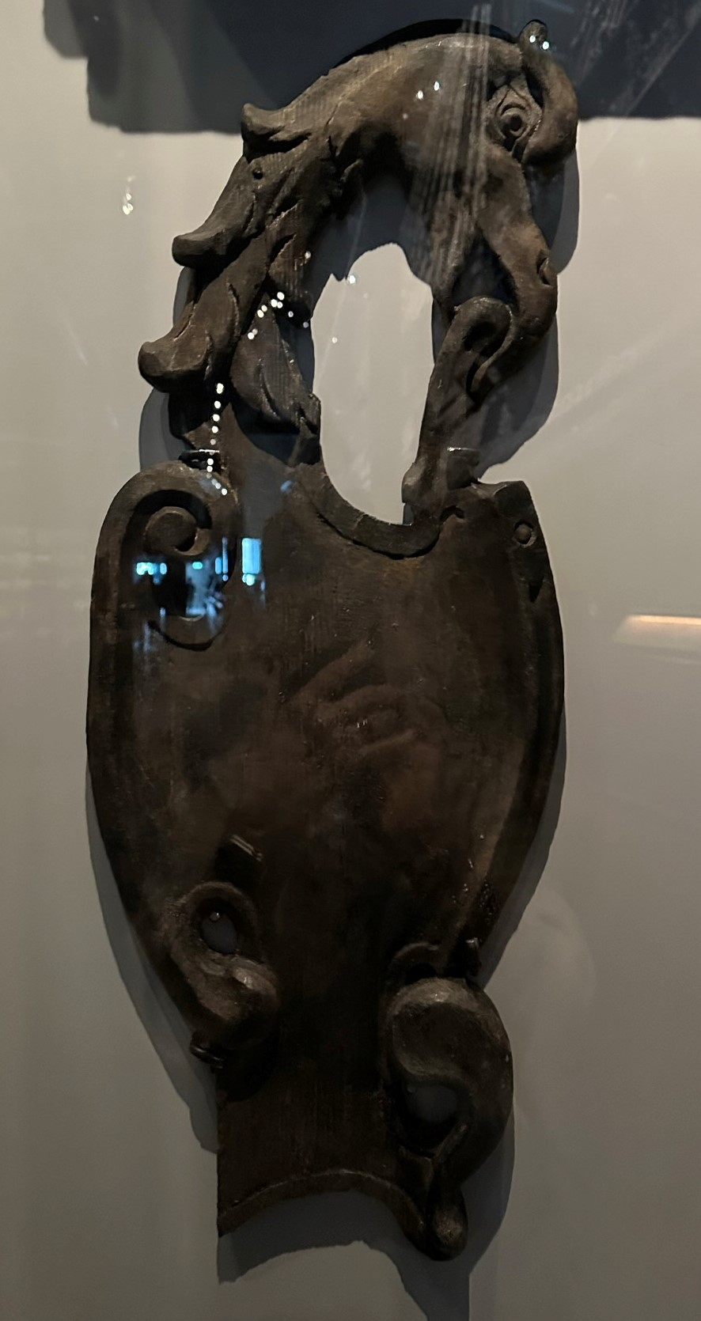
Mythical beasts, Greek Gods, Rampant Lions all to show STRENGTH and POWER.
All in glorious colour, this must have made a forceful impression.

Slide 15
STRENGTH and POWER can be interpreted not only with 2 dimensions on paper or canvas but sculpted in this case using wood.
We can reflect on some of the following:-
Narrow might cut through the water more quickly.
The weight of the elaborate sculptures on the sides would have created an imbalance.
The emphasis on showing POWER was too predominant.
Wood does float but it is also very heavy.
The highly decorated canon flaps would have been heavy and awkward to move ( Many have lion’s heads on them)
Remember art and design are all around us.

